Slide 1

Introducing Mathematics
Lesson Study in South Africa
BRIDGE Pre-Service Teacher Development CoP
15 March 2017
Ronél Paulsen
paulsr@unisa.ac.za

Slide 2
Abstract
Lesson study is a popular professional development process that Japanese teachers engage in to systematically examine their practices.
The goal of lesson study is to improve the learning experiences that teachers provided to their learners.
To understand the implications of lesson study in South Africa, it is necessary to consider the curriculum reform that took place in the country, and how these reforms challenge teachers to break away from their previous classroom practices.
The paper will reflect on the establishing of a lesson study network in Mamelodi, South Africa, and the barriers that need to be overcome for the sustainability of lesson study.

Slide 3
A brief look at Lesson Study
Lesson Study is a popular professional development process that Japanese teachers engage in to systematically examine their practice. The goal of lesson study is to improve the learning experience that teachers provide to their students. It is a wide spread practice in Japan with a long history. The Japanese word for Lesson study is Jugyokenkyo.

Slide 4
A brief look at Lesson Study
Jugyo means lesson and kenkyo means study or research. Lesson study is often conducted by teachers who gather at schools, clubs, government organisations and teacher training programmes. The most popular form of lesson study is “Konaikenshu”. Konai means “in school” and kenshu means training. Konaikenshu is a form of in-school training that brings together the staff of a school to work on a sustaining and focussed manner on a school wide goal. A common practice is to make a school-like Kenshu goal a Lesson Study goal. In fact, Lesson Study is by far the most common activity conducted during Konaikenshu. The focus of during a Konaikenshu session would be typically on the following three main activities:

Slide 5
A brief look at Lesson Study
First, the teachers examine the current condition of student learning and identify some areas that need to be improved. Then they create a lesson study goal that the group will focus on. In order to pursuit this goal, the teachers also focus on the content area to study, such as mathematics or language arts.
Secondly, the teachers work on a small number of lessons that are meticulously planned and prepared, publicly taught and carefully discussed. These lessons are referred to as study lessons, or research lessons.
Thirdly, the teachers produce a lesson study report, that serves both to document and reflect on the lesson study activities carried out by the group.

Slide 6
Lesson study cycle
Informed by curriculum
Planning a lesson
Conducting a lesson
Observed by colleagues
Setting outcomes
Design activities
Time frame
Post lesson discussion
Reflection of lesson
Knowledge of learning
Suggestions for improvement
Adapted from Ono et al
Slide 29

Slide 7


Slide 8


Slide 9
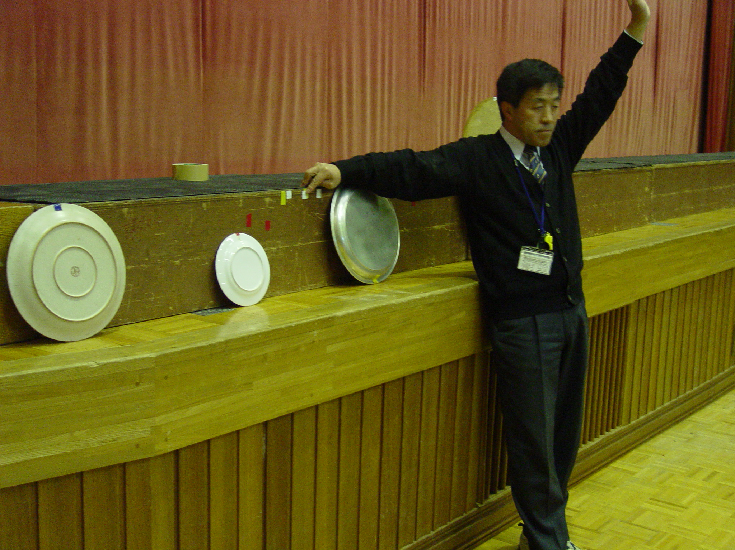

Slide 10
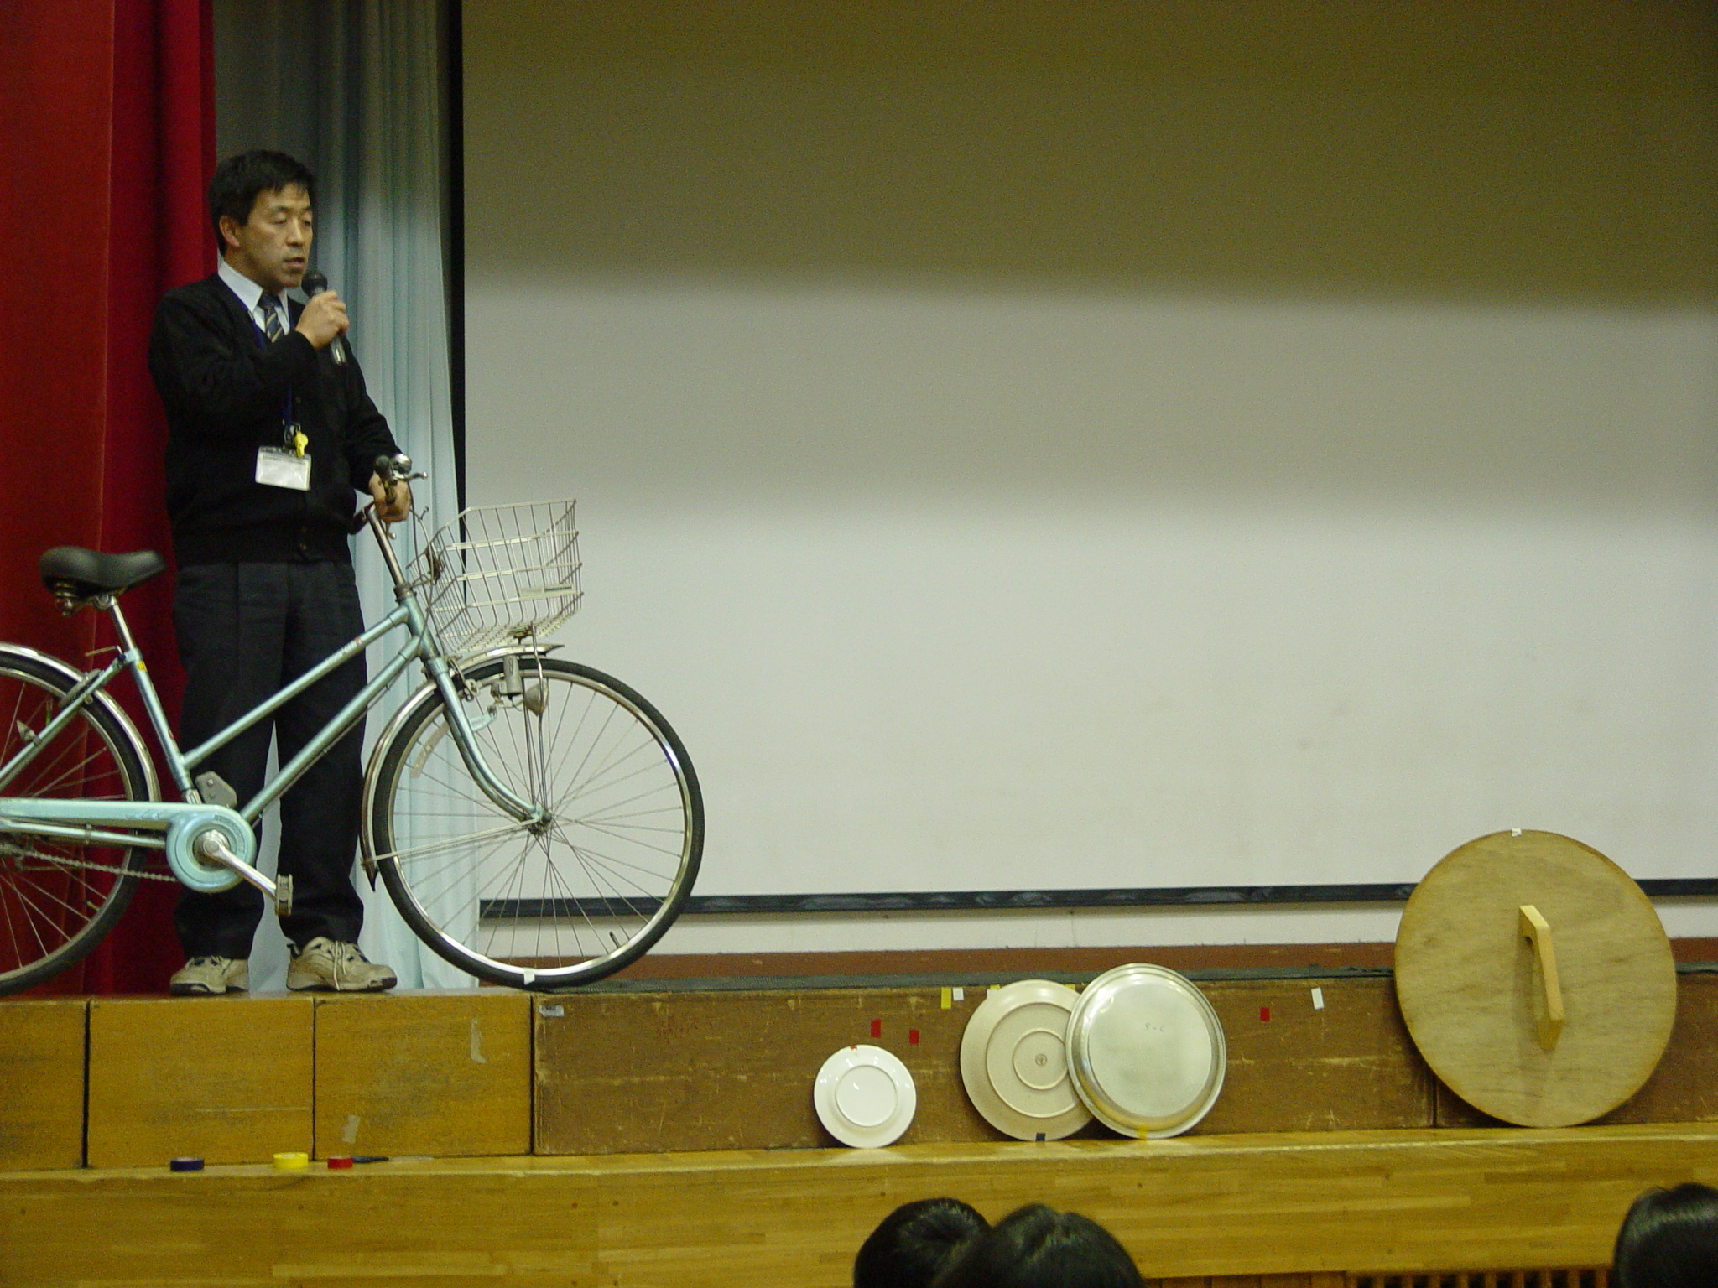

Slide 11


Slide 12


Slide 13
What makes Lesson Study different to the traditional approach to in-service training?
Outside expert
vs
Active participants
Notes:
Lesson Study is a widespread form of teacher development in Japan.

Slide 14
Traditional:
The flow is from the trainer to the trainee
In Lesson Study:
We are all participants
Notes:
Lesson Study is a widespread form of teacher development in Japan.

Slide 15
Traditional:
Trainer gives ideas
In Lesson Study:
We use our ideas and apply it in the classrooms
Notes:
Lesson Study is a widespread form of teacher development in Japan.

Slide 16
So, what do we do?
Teachers come together to discuss mathematics topics.
Then they collaboratively plan mathematics lessons around the topic.

Slide 17
The process of Lesson Study
One teacher teaches the lesson based on the plan developed by the group.
The lesson is observed by all participants.

Slide 18
The process of Lesson Study
The lesson is recorded:
Videotaped
Observation notes
Copies of learners’ work

Slide 19
The process of Lesson Study
The post discussion:
Different viewpoints are brought to the discussion, coming from different experiences
Protocol

Slide 20
The Lesson Plan is the Backbone of Lesson Study

Slide 21
The Lesson Plan
① The lesson plan supports the lesson study process, by serving as a:
Teaching tool
it provides a script for the activities of the lesson

Slide 22
The Lesson Plan
② The lesson plan supports the lesson study process, by serving as a:
Communication tool
it conveys to others the thinking of the teachers who planned the lesson

Slide 23
The Lesson Plan
③ The lesson plan supports the lesson study process, by serving as a:
Observation tool
it provides guidelines for what to look for in the lesson, and a place for the observers to record and share these observations.

Slide 24
From MRTEQ
③ Basic Competences of a Beginner Teacher:
Newly Qualified Teachers must
1. have sound subject knowledge.
2. know how to teach their subject(s) and how to select, determine the sequence and pace of content in accordance with both subject and learner needs.
3 know who their learners are and how they learn; they must understand their individual needs and tailor their teaching accordingly.
4 know how to communicate effectively in general, as well as in relation to their subject(s), in order to mediate learning.
5. have highly developed literacy, numeracy and Information Technology (IT) skills.
6. be knowledgeable about the school curriculum and be able to unpack its specialised content, as well as being able to use available resources appropriately, so as to plan and design suitable learning programmes.
7. understand diversity in the South African context in order to teach in a manner that includes all learners. They must also be able to identify learning or social problems and work in partnership with professional service providers to address these.
8. must be able to manage classrooms effectively across diverse contexts in order to ensure a conducive learning environment.
9. be able to assess learners in reliable and varied ways, as well as being able to use the results of assessment to improve teaching and learning.
10. must have a positive work ethic, display appropriate values and conduct themselves in a manner that befits, enhances and develops the teaching profession.
11 must be able to reflect critically on their own practice, in theoretically informed ways and in conjunction with their professional community of colleagues in order to constantly improve and adapt to evolving circumstances. [See Appendix C p 62]

Slide 25
What makes LS successful in Japan?
Not restricted to Mathematics only
Voluntary
School hours
Pre-service teachers
“Knowledgeable others”
Open LS Houses
Reports
Work ethic

Slide 26
What makes LS successful in Japan?
Not restricted to Mathematics only
Voluntary
School hours
Pre-service teachers
“Knowledgeable others”
Open LS Houses
Reports
Work ethic

Slide 27
The advantages of Lesson Study
Different from other INSET programmes
Moves into the classroom
Peer collaboration – community of LS practitioners
Emphasis on how children learn – not on what teachers teach
Become more aware of classroom practices
Manipulatives
Reflect/Metacognition
Lesson planning

Slide 28
Mamelodi Lesson Study Project

Slide 29
Mamelodi means
the
Mother of Melodies

Slide 30
The logo for the project is a sunflower. It is symbolic to the sunflower that turns her head towards the sun, her source of energy, and then distributes her seeds to create energy to those who will use her seeds.

Slide 31
The “sun” is Mathematics
The community of practice are the sunflowers.
The seeds will be the effect that we have in the classroom.
The seeds of the sunflower energises the learners in the classroom.
The water and fertiliser will be the effort that we put into the project to make the seeds grow.
We can plant the seeds again to help the next generation of the sunflower

Slide 32
With this project we hope to spread the seeds of Mathematics to the learners in our schools.
Once the project has firm roots in the selected schools, we want to sow the seeds in other schools in Mamelodi.

Slide 33
Lesson study looks deceitfully simple.
Slide 6

Slide 34
We deal with content knowledge
We deal with pedagogical content knowledge
We use concrete materials
We simulate a classroom situation

Slide 35
We follow the procedure…
We plan a lesson…

Slide 36
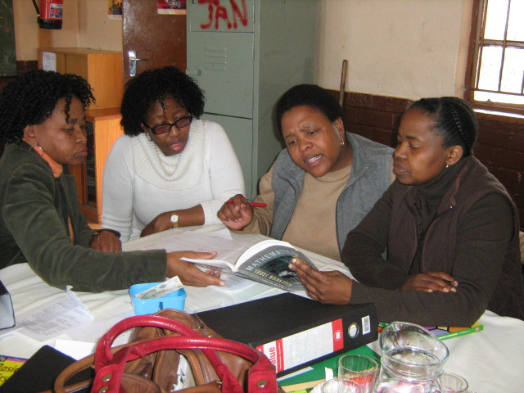

Slide 37
We set up a classroom with eager learners

Slide 38


Slide 39
We engage ourselves in the learners’ activities

Slide 40


Slide 41


Slide 42
We discuss the lesson

Slide 43
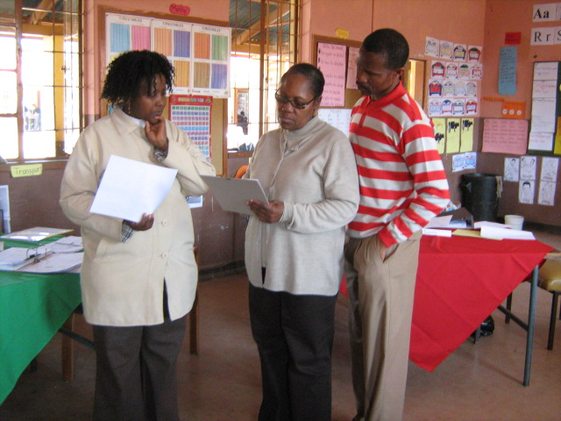

Slide 44
We redesign the lesson

Slide 45
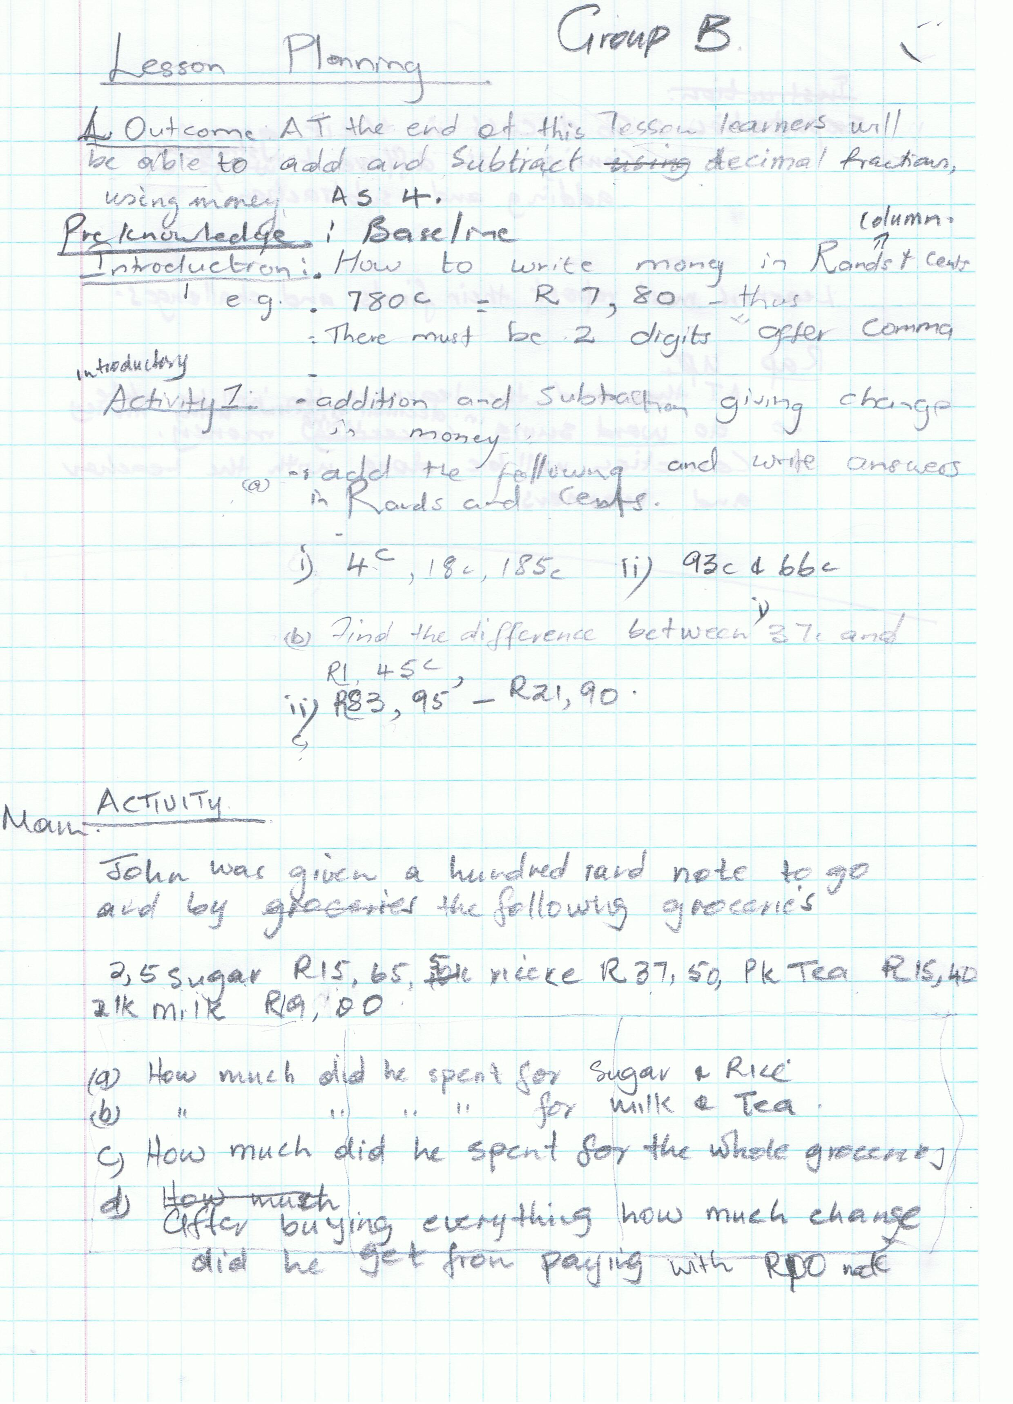

Slide 46
Snapshot (lesson on volume of a rectangular prism)

Slide 47
Challenges

Slide 48
Content knowledge
①
most important barrier that will have to be overcome
still text-book bound, and traditional teaching methods still prevail
teachers misunderstood their role as facilitators - “everything goes”
diagnostic test

Slide 49
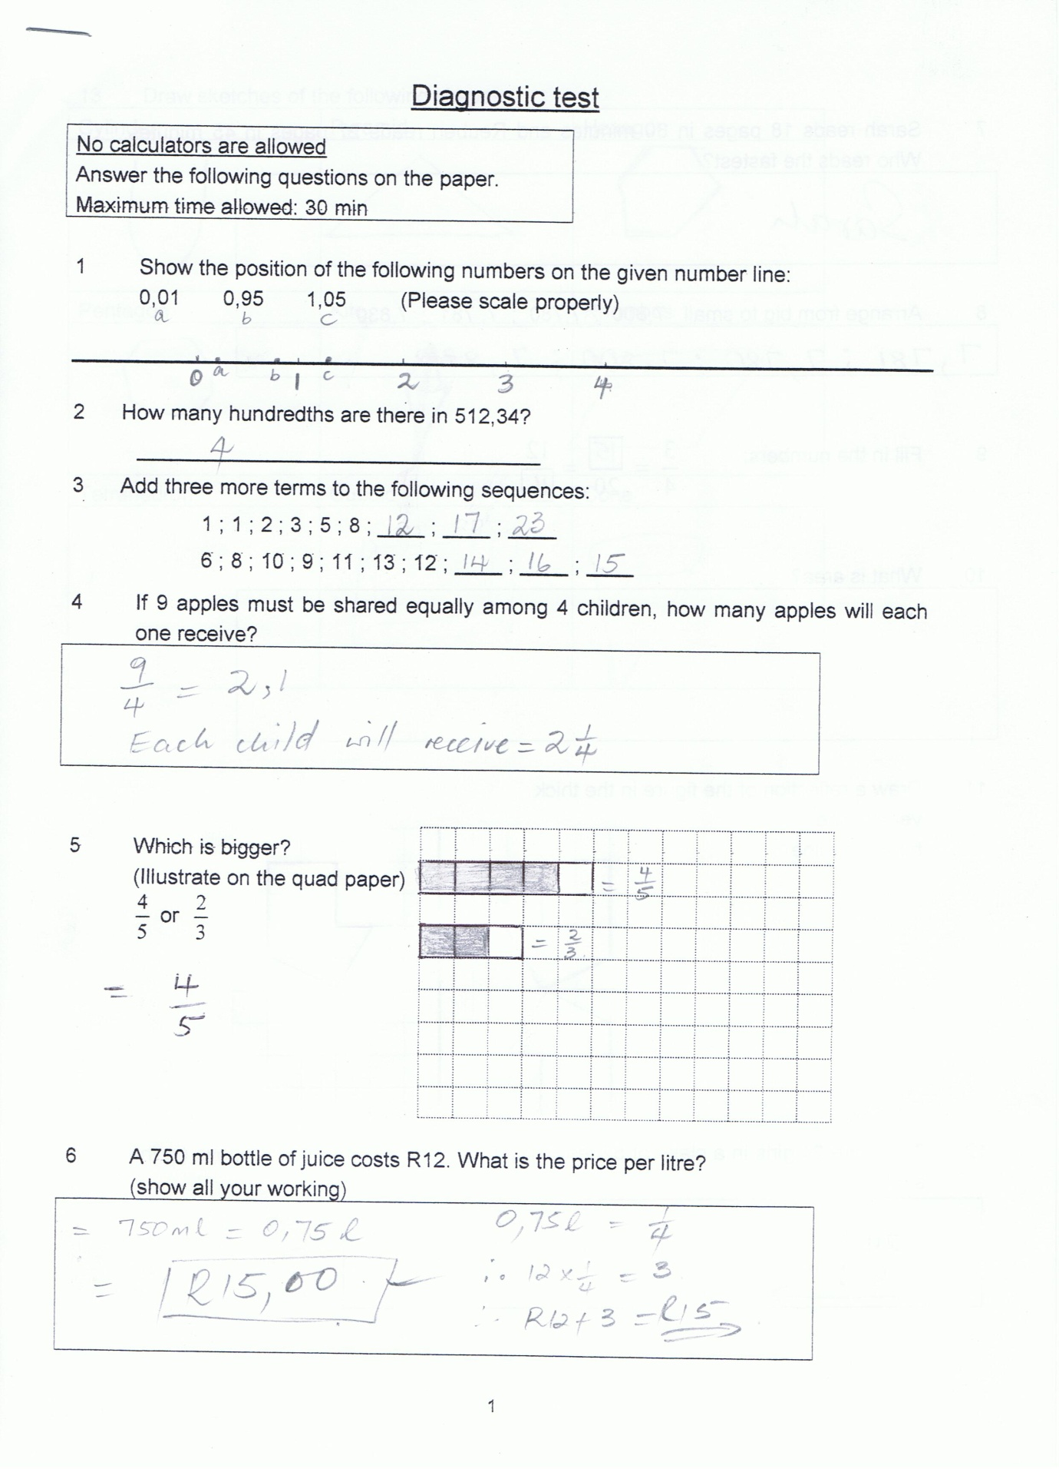
Content knowledge

Slide 50
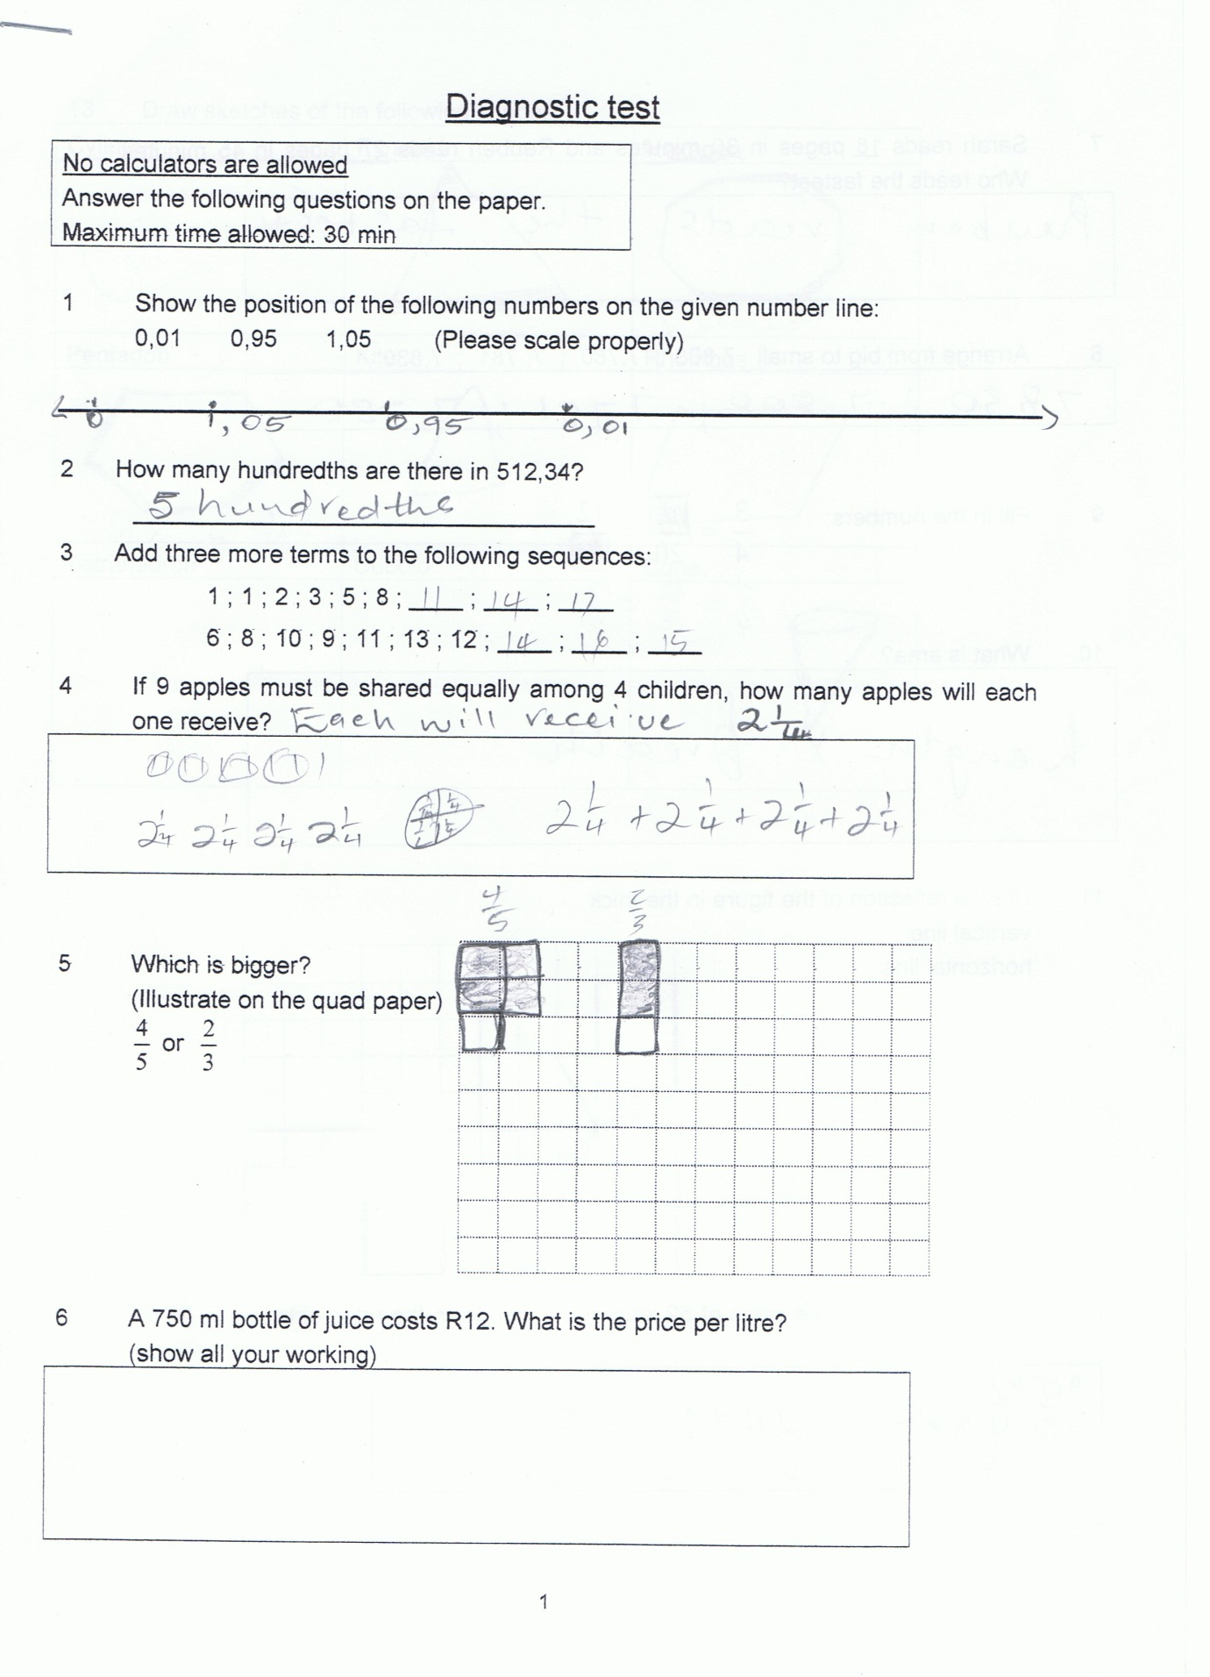
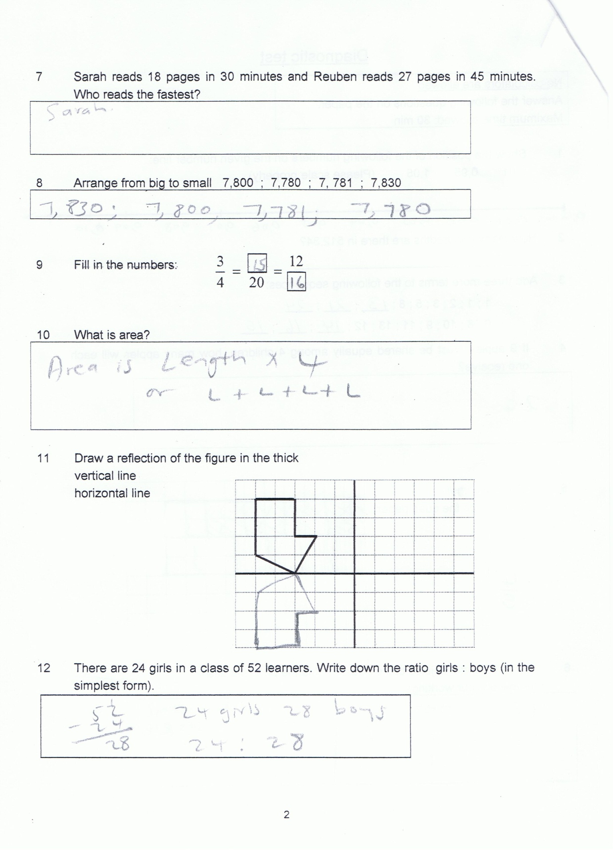
Content knowledge

Slide 51
Pedagogical content knowledge (pck)
②
Shulman identified subject matter knowledge and pedagogical content knowledge (pck) as key variables influencing teachers’ decisions in the classroom.
Content knowledge influences pedagogical approaches. Through better understanding the content, teaching and learning can be better aligned.

Slide 52
Pedagogical content knowledge (pck)
The capacity of a teacher to transform the content knowledge he or she possesses into forms that are pedagogically powerful and yet adaptive to the variations in ability and background presented by the students.

Slide 53
Mathematical knowledge for teaching (MKT)
③
The mathematical knowledge that teachers have in order to do the mathematical work of teaching effectively. This body of professional knowledge includes four components:
Common knowledge of math content
Specialised knowledge of mathematics content
Knowledge of mathematics and students and
Knowledge of mathematics and teaching

Slide 54
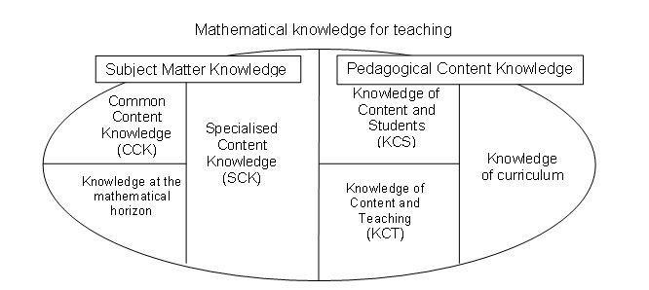
Mathematical knowledge for teaching (MKT)
③

Slide 55
Resources
④
To get the math resources is not the problem
How to use these resources is the barrier

Slide 56
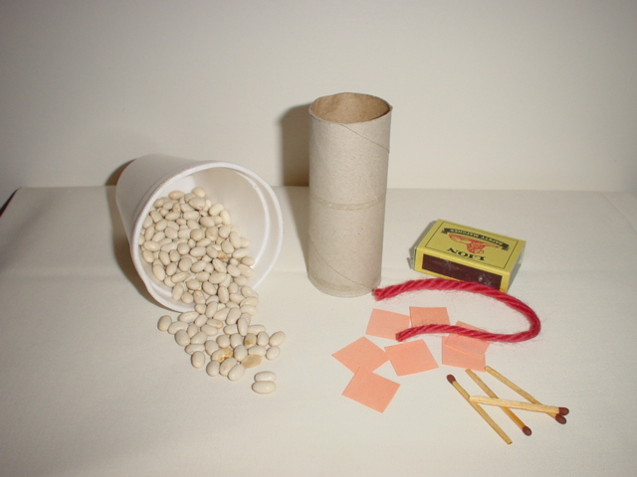
Resources for Measurement

Slide 57
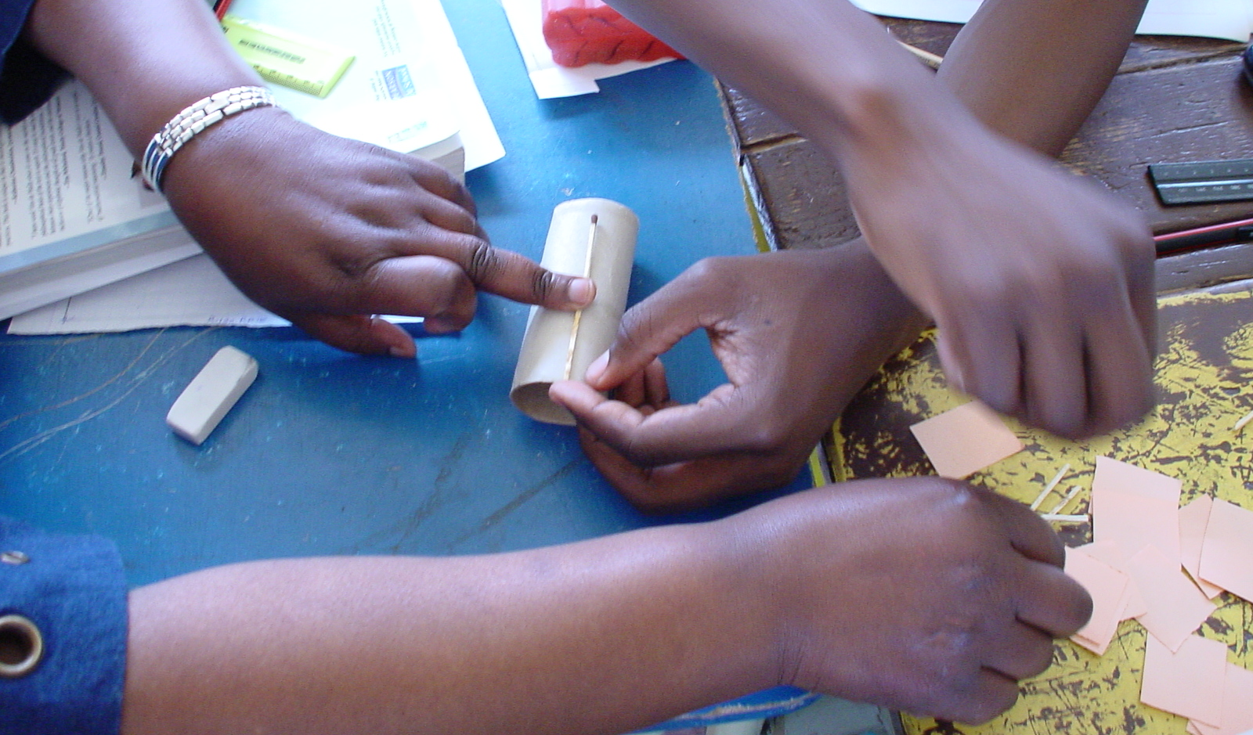
Understanding length

Slide 58
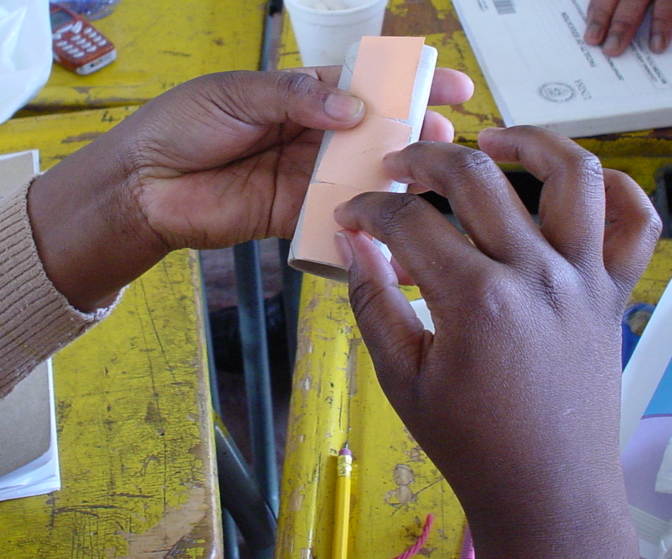
Understanding area

Slide 59
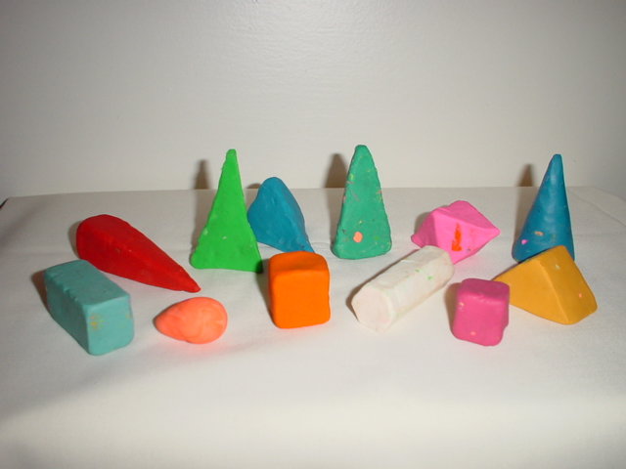
Building clay solids

Slide 60
Time management
⑤
Planning:
A lesson
A week’s lessons
A term
A year
Use your time fruitfully

Slide 61
Lesson planning
⑥
Lesson planning form the backbone of Lesson Study
Lesson planning guidelines from the Department
Teachers had no formal training in Lesson Planning

Slide 62
Lesson planning
What does the Department of Education provide?

Slide 63
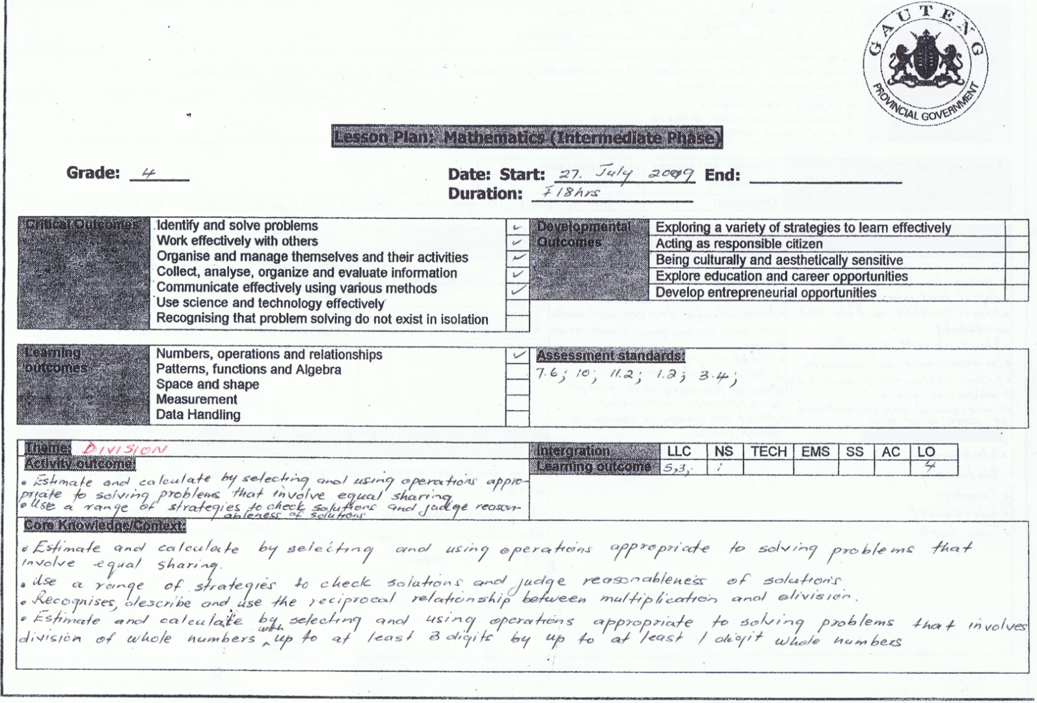
Lesson planning

Slide 64
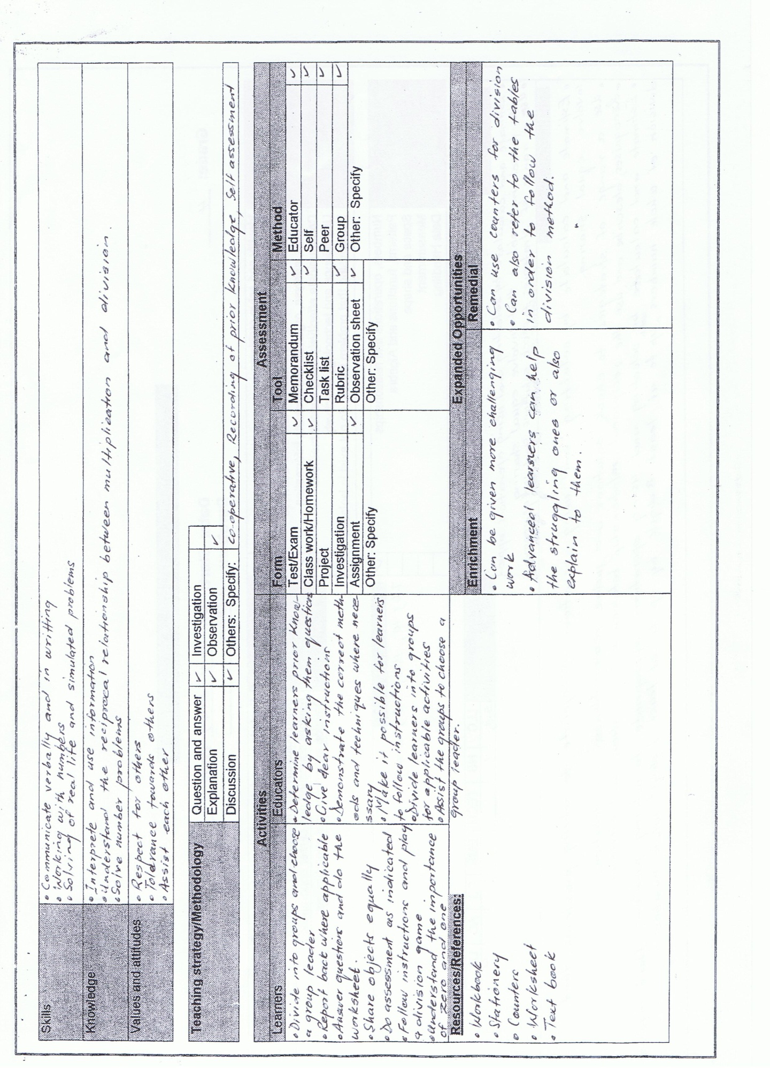
Lesson planning

Slide 65
Peer collaboration
⑦
Teachers work in isolation

Slide 66
The reality
What went wrong…
Tasks set for learners
Sequencing of the learning trajectory
Teachers took on the role of extra hands – interference of the thinking processes
Comments /critique
Evaluation of lessons
Collecting data – what must we look for?
Articulating observations

Slide 67
Endeavours
Setting tasks to promote mathematical thinking
Engage in problem solving
Understanding mathematical proficiency:
  Conceptual understanding
  Procedural fluency
  Strategic competence
  Productive disposition

Slide 68
Those who are interested in implementing Lesson Study cannot overlook the substantial challenges that must be overcome to make the practice purposeful and powerful.

Slide 69
Those who are interested in implementing Lesson Study cannot overlook the substantial challenges that must be overcome to make the practice purposeful and powerful.

Slide 70
What makes Lesson study successful?
Teachers must be prepared to
commit to the task
spend time
become aware of student thinking
collaborate
reflect on their classroom practices
CHANGE…

Slide 71


Slide 72


Slide 73
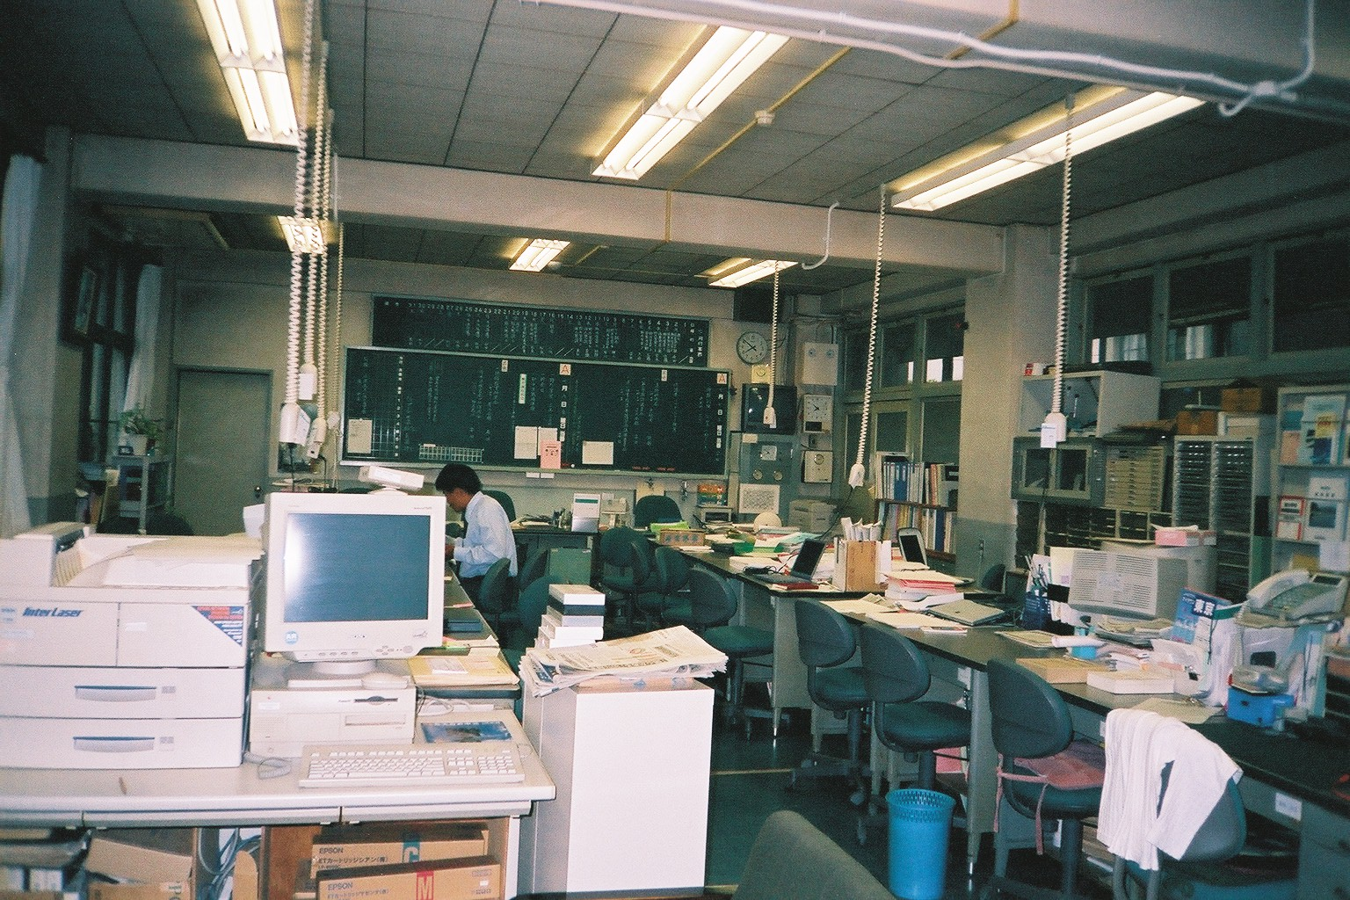

Slide 74
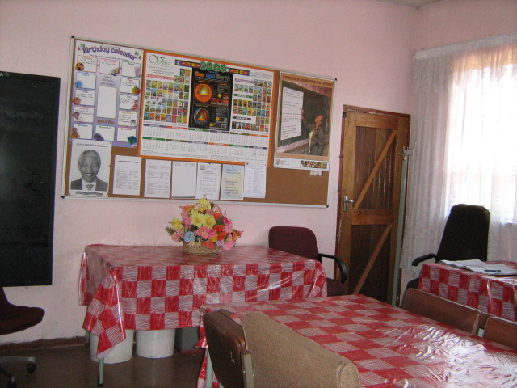

Slide 76

Thank you
Ronél Paulsen

