Slide 1
CONNECTing…

Slide 2
CONNECT Verb: bring together or into contact so that a real or notional link is established
Synonyms:
Join* link* anchor* bond

Slide 3
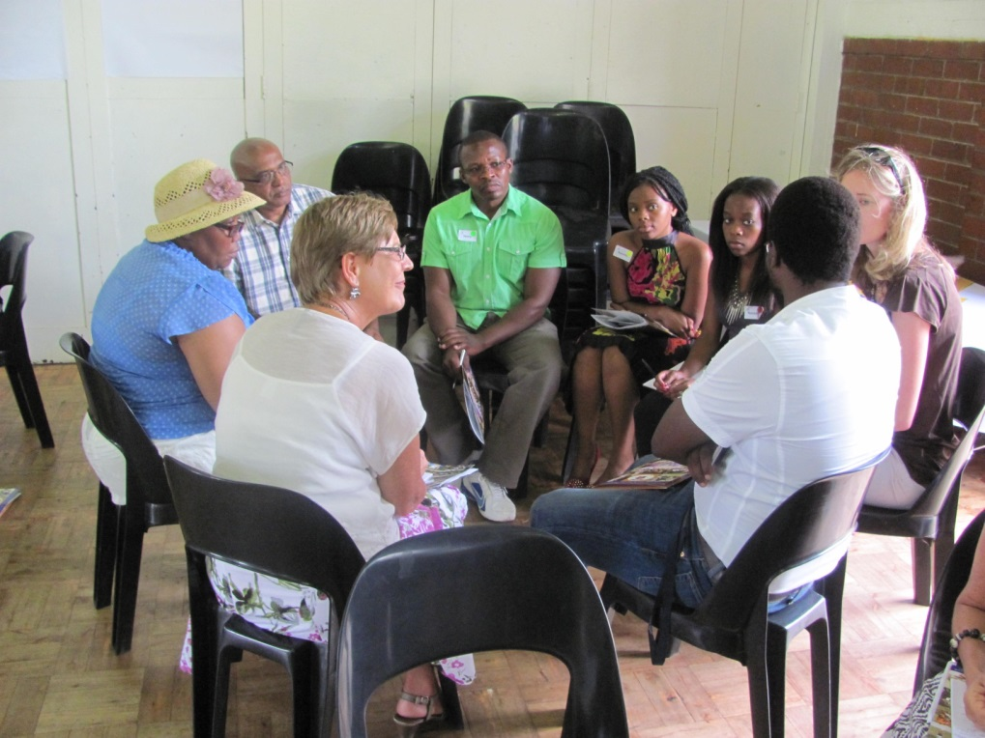
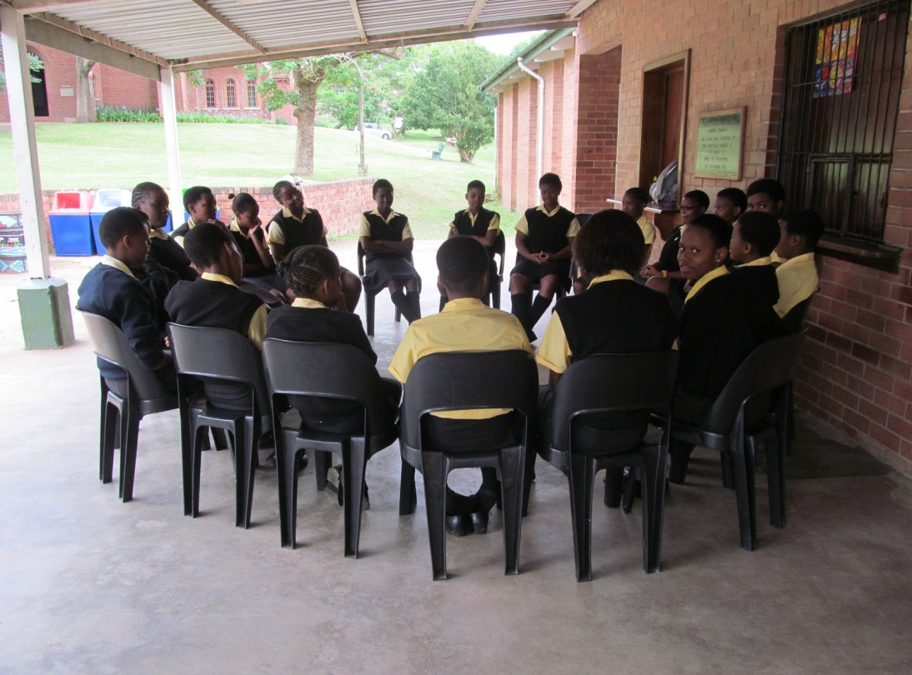

Slide 4
CONNECT
Themes
Leadership
Engagement
Student to student
Development of skills
Evaluation of Data
Team building
Student to teacher
Student to material
Academics
Discipline
Current Issues
Homogenous groups
Reflection
Communication
Strategic Planning
Leadership Committees

Slide 5
Themes for CONNECTing…
Study skills – Studying smarter
Taking responsibility as a student
So you think you can write exams
Results and Pass Requirements
What’s cluttering up your life?
Democracy and Elections
Emotional Intelligence
Servant Leadership
Student review and development
Learning styles

Slide 6
Meetings
Problem-solving
Checking-in
Discipline
LO
CONNECT
Mentoring
Academics
Reflecting

Slide 7
the art of difficult conversation

Slide 8
Reflections

