Slide 1
Reflection Meeting
BRIDGE Western Cape CoP meeting
22nd November 2017

Slide 2
Outline
Welcome & Introduction
Reflection and Sharing
Summary of CoP progress and developments:
School Leadership
Early Childhood Development
Teaching and Learning
Post School Access
BRIDGE CoP reflection
Re-imagine CoPs in 2018

Slide 3
What has happened for me in 2017?

Slide 4
School Leadership
4 meetings held: March, June, August, October
Attendance up and down but averaging 8 people
Focus shifted in August meeting to look at the concept of transformational leadership and how this applies to school leadership in the SA context
One of the premises of transformational leadership is to make ‘existing systems more effective at doing what they have always been intended to do’ The case for Transformation, p3.
Characteristics of a transformational leader: adaptive capacity, comfortable with discomfort and flux, encouraging, active listener, collaborative
This has led to the draft of a questioning framework that can be used by school leaders to work through their specific context

Slide 5
Outline of Questioning Framework
Personal
Am I ready to lead?
Relational
Are others ready to lead?
Instructional
How can I lead to achieve quality?
What is my role in supporting others to lead?
Operational
What underlying structures will support good leadership?

Slide 6
Early Childhood Development
4 meetings held: March, July, September October
ECD Stakeholder meeting was well attended by 40 people including national congress, NECDA – the main bodies in the ECD space
Good involvement and representation from WC DSD to explain revision in Partial care and ECD Programme Registration Process.
Presenting and understanding the various registration options available to practitioners. Representatives from WCED and DSD to speak on the 2016 bill that reconfigures
Various TVET colleges spoke on the changes by the ETPSETA to the level 4 occupational qualification, BRIDGE made a collective submission of recommendations in July 2017.
Linda Biersteker presented the ‘Career Lattice’ to frame career progression within the ECD space.

Slide 7
Teaching & Learning
4 meetings
Focus on defining principles of teaching and learning
WC Gamechanger in 2016 had put together some indicators of quality but BRIDGE CoP focused more on operational and organizational pieces rather than pedagogical indicators
Document developed into a set of 10 statements of what you need to pay attention to in quality teaching and learning: engagement is critical; foundations are key; relevant and just curriculum; supporting teachers; language matters; creating a nurturing environment; using the right tech at the right time with the right facilitator; multiple ability levels – not fixed.
Invite to endorse the document product – Kayin to send out to group

Slide 8
Post-school Access
3 meetings held: July, September October
Up and down attendance averaging 10
Conversation has focused on looking at 3 post-school maps: BRIDGE, YAZI, DGMT and providing feedback and 21st Century Skills
Some involvement from WCED, Senior Curriculum Planner: Life Orientation/Life Skills to outline what is being done in the way of career guidance education through LO channels.
Proposed next steps: Action research project to understand how the impact of the various existing initiatives can be cascaded and scaled. Core group of CoP members will steer the development of the project with Mr Teladia into 2018, and including any interested NGOs.

Slide 9
National Developments
Axis Summit, South Africa Extraordinary Schools Coalition came together to celebrate what had been done in the sector – growing into narrative
SA council of Churches – national convention process new initiative - ,movement citizens assuming rightful responsibility to liberate and active voice to call people out – activism
Developments in partnering and profiling pre-service and in-service teacher training initiatives e.g. Realema’s teaching internship, Inanda/Zenex internship, UJ’s Teaching Practice School, Thandulwazi Intern Teacher Training Programme, and the DHE-EU initiative on an overall teacher education capacity building project called TLDCIP (Teaching and Learning Development Capacity Improvement Project)
BRIDGE has updated its map of ECD RTOs to provide up to date information on the size, scope, capacity and distribution of RTOs across South Africa. Find it at http://www.bridge.org.za/knowledgehub/bridge-ecd-rto-map.
Engaging with decision-making and lobbying bodies in the sector including Congress and NECDA.
Data Visualisation Project to translate qualitative and quantitative data into interpretable and usable information

Slide 10
BRIDGE COP reflection
What has made me come back to the meetings this year?
How would I like BRIDGE’s CoP’s to look in 2018?
How can we balance between the in the moment conversations and output orientation?
What other connections do we need to make as a group e.g. coalition?

Slide 11
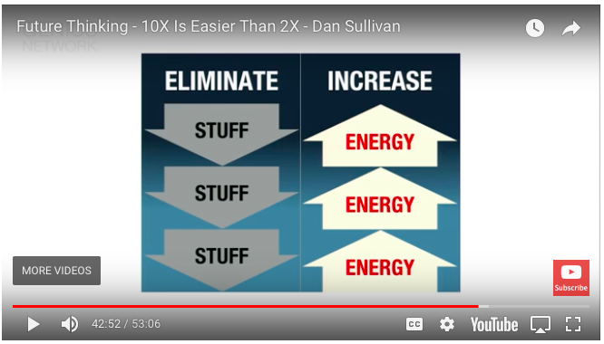
Re-imagining the CoPs for 2018

