Slide 1
7 June 2016
Bridge Maths & Science CoP
OPEN EDUCATIONAL RESOURCES
NOLWAZI PLATFORM

Slide 2
At the heart of the movement towards
Open Educational Resources (OERs)
is the simple and powerful idea that
the world’s knowledge is a public good
and that technology in general and the Worldwide Web in particular provide
an extraordinary opportunity for everyone
to share, use and re-use knowledge.
Atkins, Brown, & Hammond: A Review of the Open Educational Resources (OER) Movement: Achievements, Challenges, and New Opportunities February 2007
7 June 2016
Bridge Maths & Science CoP

Slide 3
What are OERs?
text
modules
syllabi
full courses
textbooks
tests
software
lesson plans
quizzes
simulations
apps
lecture notes
assignments
projects
animations
images
audio
video
course materials
etcetera
7 June 2016
Bridge Maths & Science CoP

Slide 4
For what purpose?
Teaching
Learning
Assessment
Research
7 June 2016
Bridge Maths & Science CoP
Notes:
Yup. Marie Curie – virtually the ONLY female scientist most people recognise.
And…

Slide 5
For whom?
Public domain
Accessible
Anyone
7 June 2016
Bridge Maths & Science CoP

Slide 6
A process as well as a set of products
Offered freely and openly
Share
Use
Reuse
Re-purpose
Translate
Improve
Adapt
Remix
Re-share
7 June 2016
Bridge Maths & Science CoP
Notes:
Yes. All well-known and male.
100% correct!

Slide 7
Choice
Diversity of formats
Diversity of technical platforms
Diversity of delivery mechanisms
7 June 2016
Bridge Maths & Science CoP

Slide 8
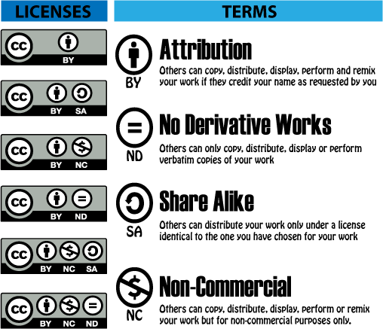
creativecommons.org n.d
7 June 2016
Bridge Maths & Science CoP

Slide 9
Content value chain
DEVELOPMENT
USE
CURATION
DELIVERY
SOURCING
COMMUNICATION & SUPPORT
BUSINESS DEVELOPMENT & MARKETING
7 June 2016
Bridge Maths & Science CoP

Slide 10
Free-to-end-user
Advocacy Campaign: Zero-rating for OER platforms
7 June 2016
Bridge Maths & Science CoP

Slide 11
Higher purpose?
Content consumer
Content-creator
Content sharer
7 June 2016
Bridge Maths & Science CoP
Notes:
Finally – a black female scientist and inventor!

Slide 12

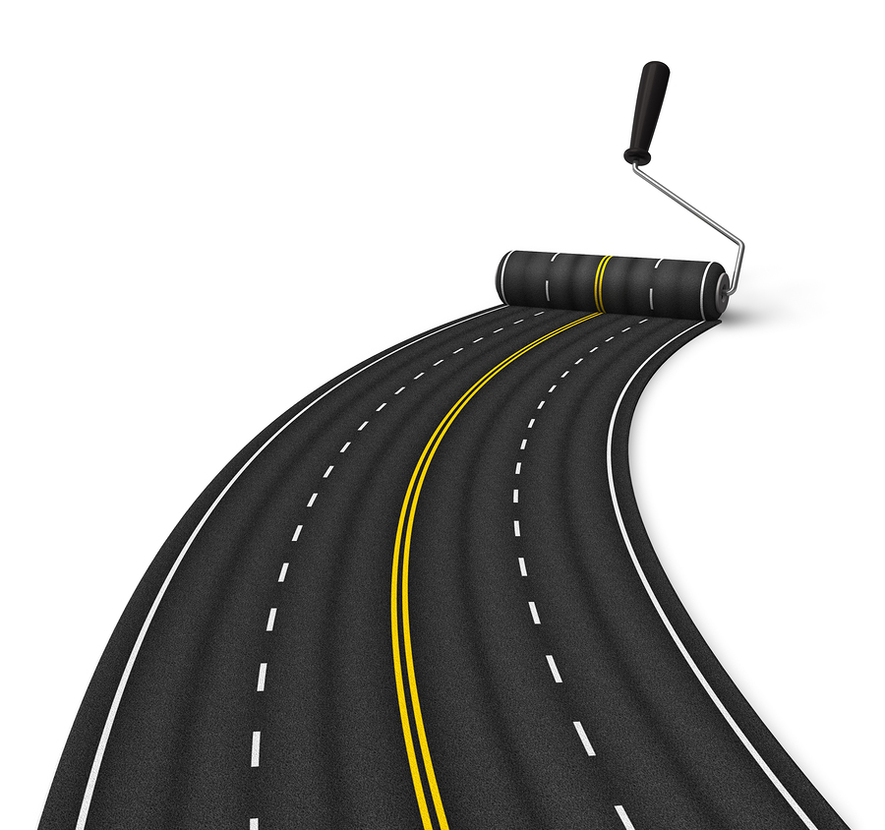
Our Story……
The Road to Nolwazi

Slide 13
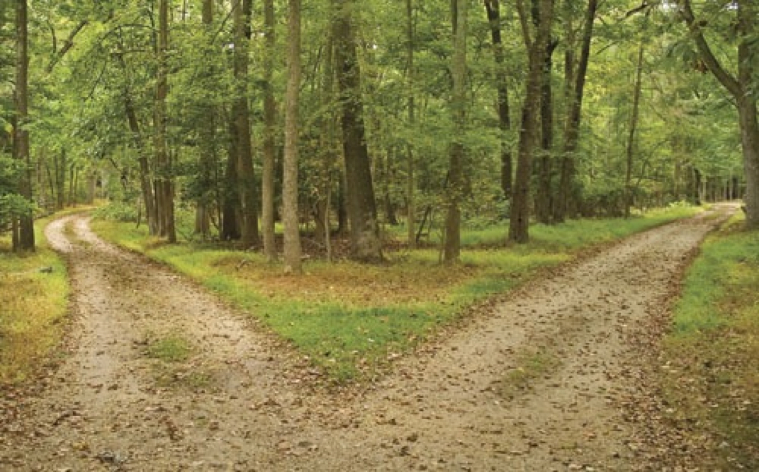
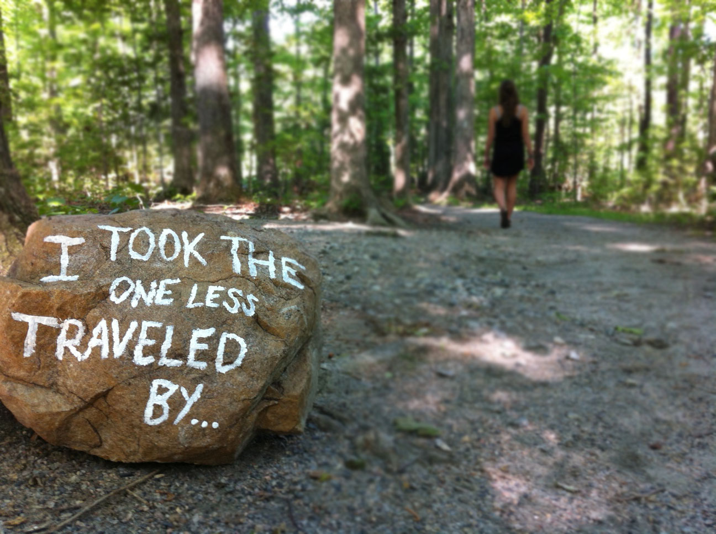

Slide 14

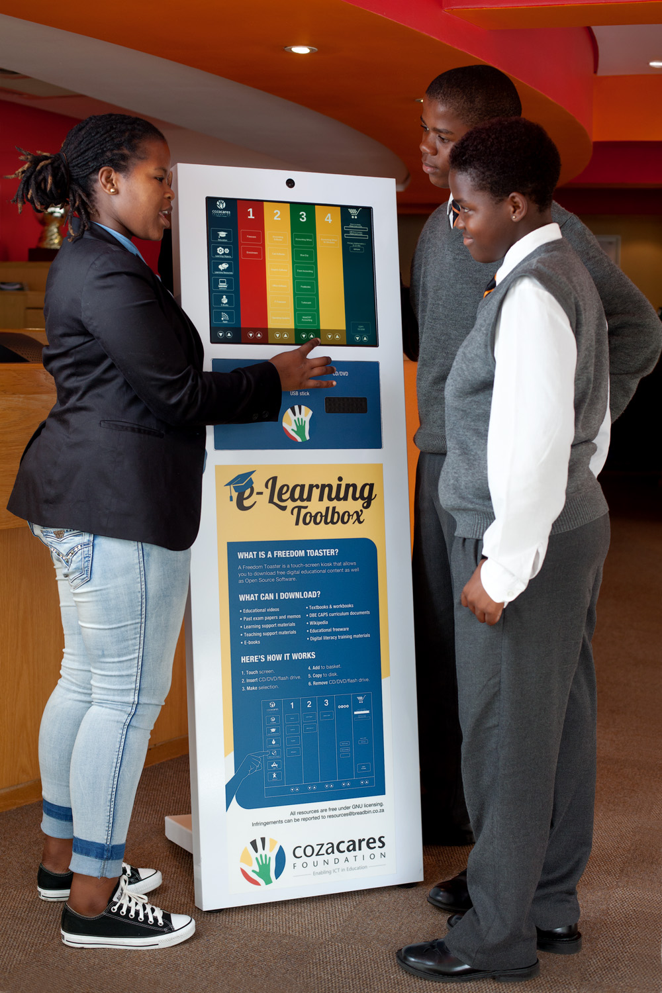
Breadbin begins…
Free & Open Source Software (FOSS)
Open Educational Resources (OERs)
Social impact
FOSS/OER evangelism
7 June 2016
Bridge Maths & Science CoP

Slide 15


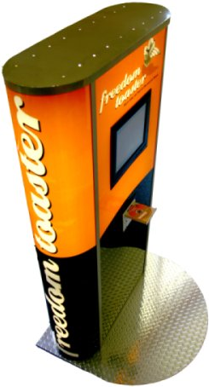
EASY TO USE
Freedom Toaster Project
Open Source & Open Content
Off-line access
EASY TO USE!
“Teachers’ Toolbox”
John Thole - Edunova
The Digital Education Show Africa 2015
7 June 2016
Bridge Maths & Science CoP

Slide 16

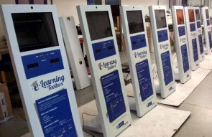
Western Cape Education Department
8 District offices
16 617 interactions - 2012
7 June 2016
Bridge Maths & Science CoP

Slide 17
Easy to use
OERs WORK!
CUSTODIAN SUPPORT
FRESH CONTENT
Freedom Toaster Project
Open Source & Open Content
Off-line access
EASY TO USE!
“Teachers’ Toolbox”
John Thole - Edunova
The Digital Education Show Africa 2015
7 June 2016
Bridge Maths & Science CoP

Slide 18

Breadbin techies attempt to judge quality education material
7 June 2016
Bridge Maths & Science CoP

Slide 19
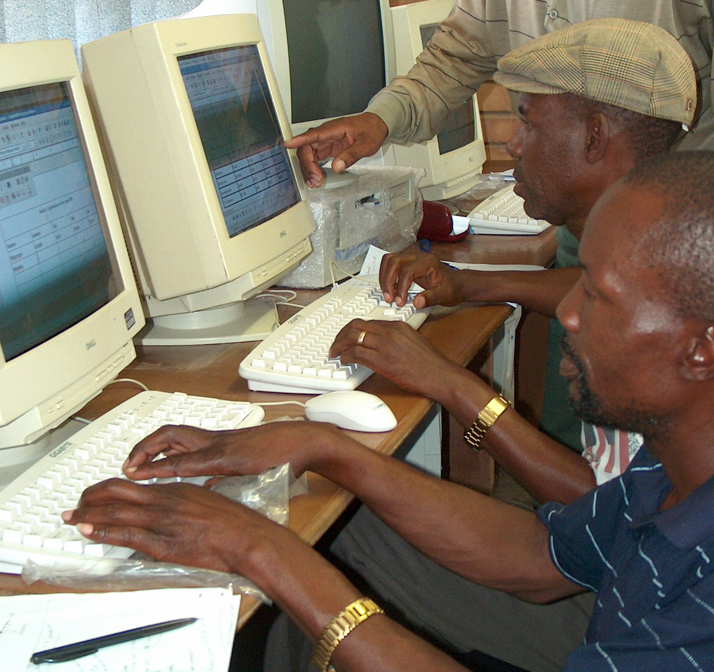
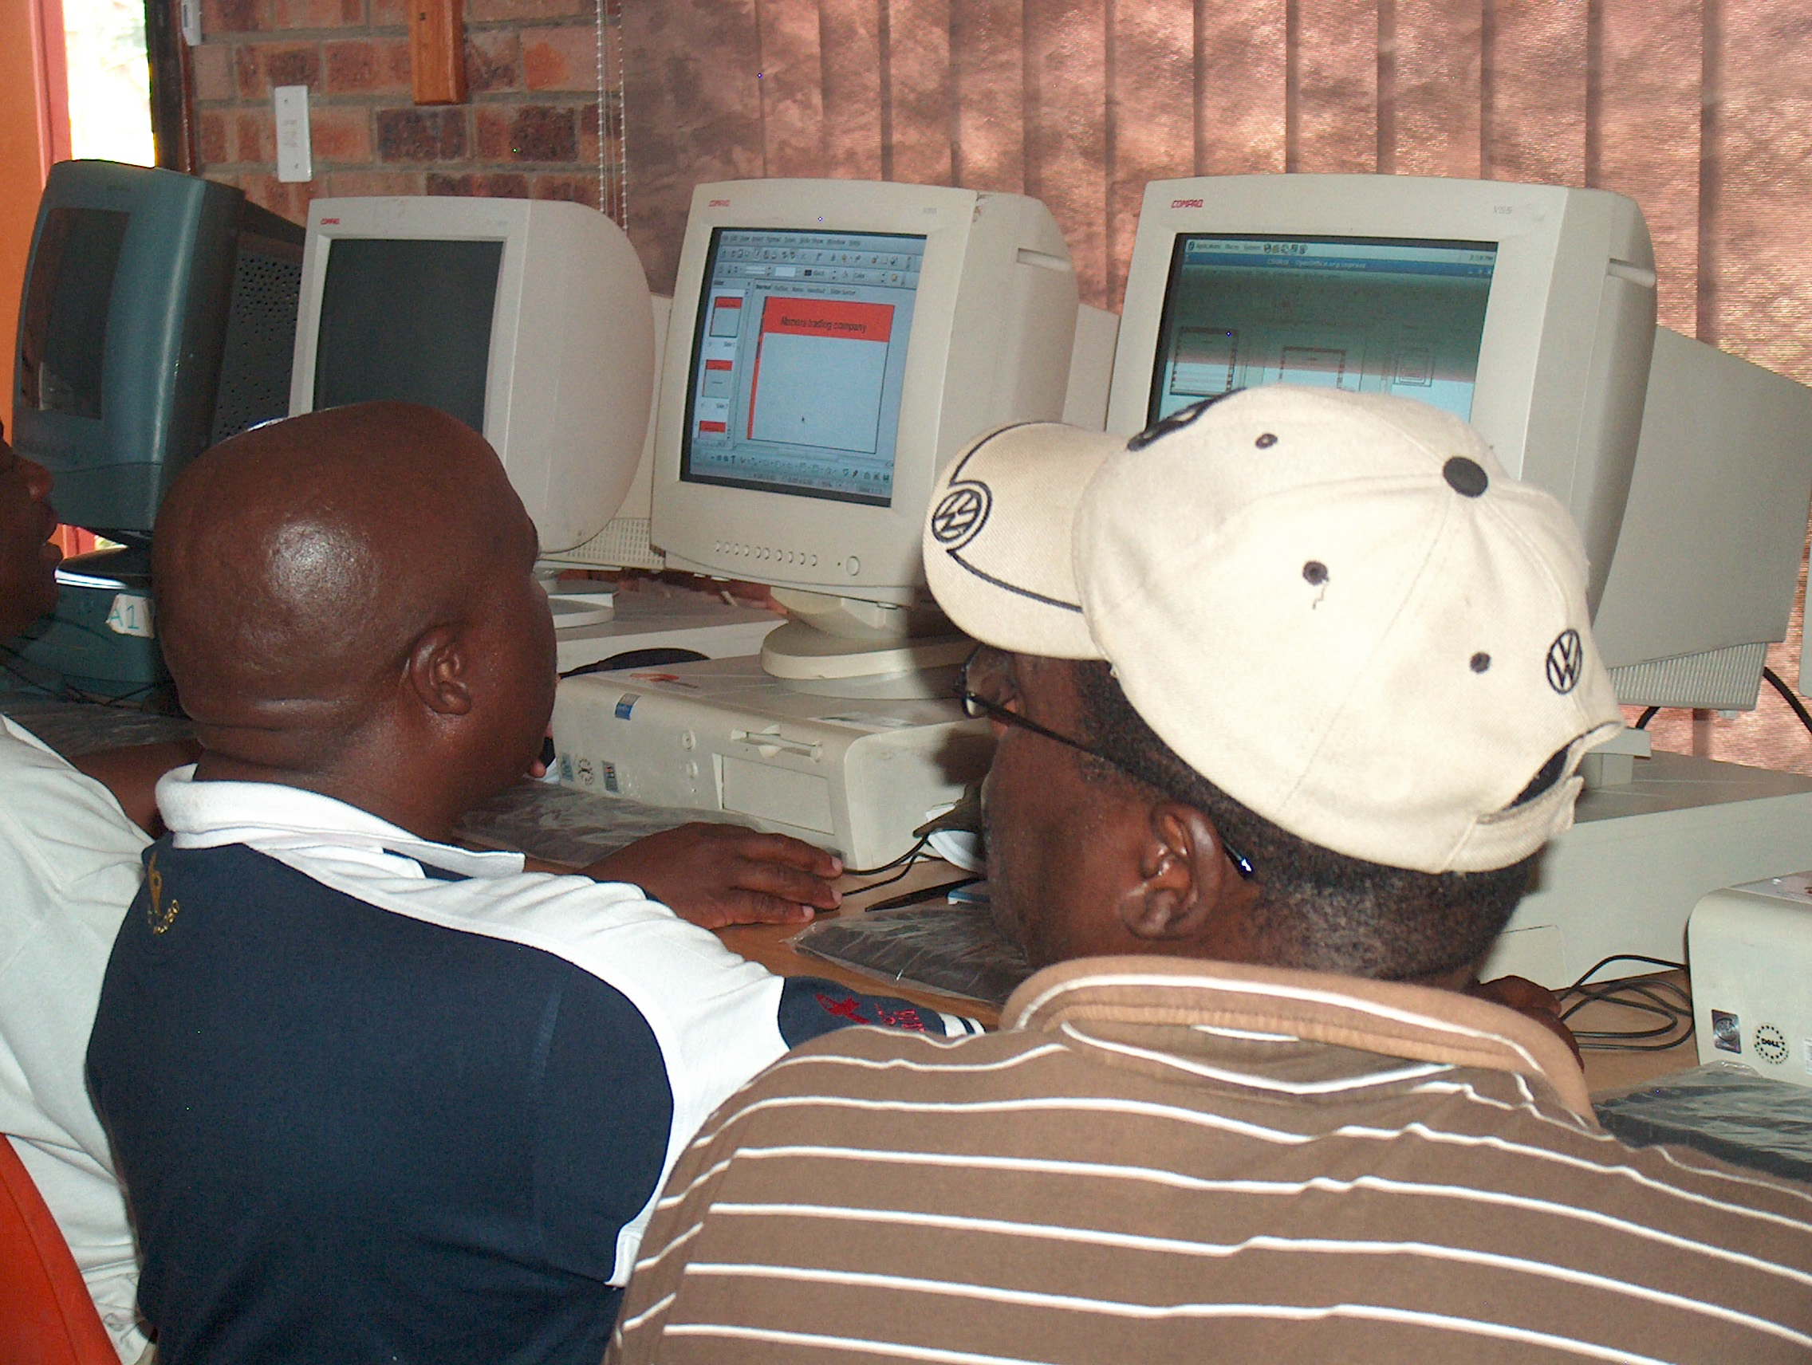

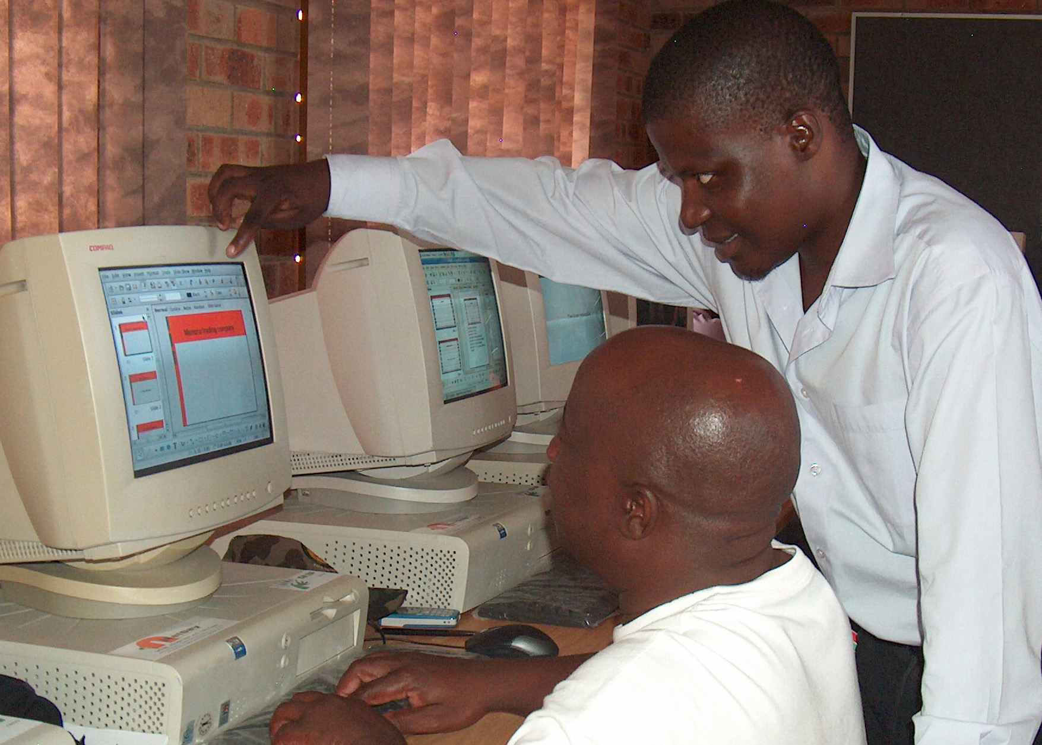
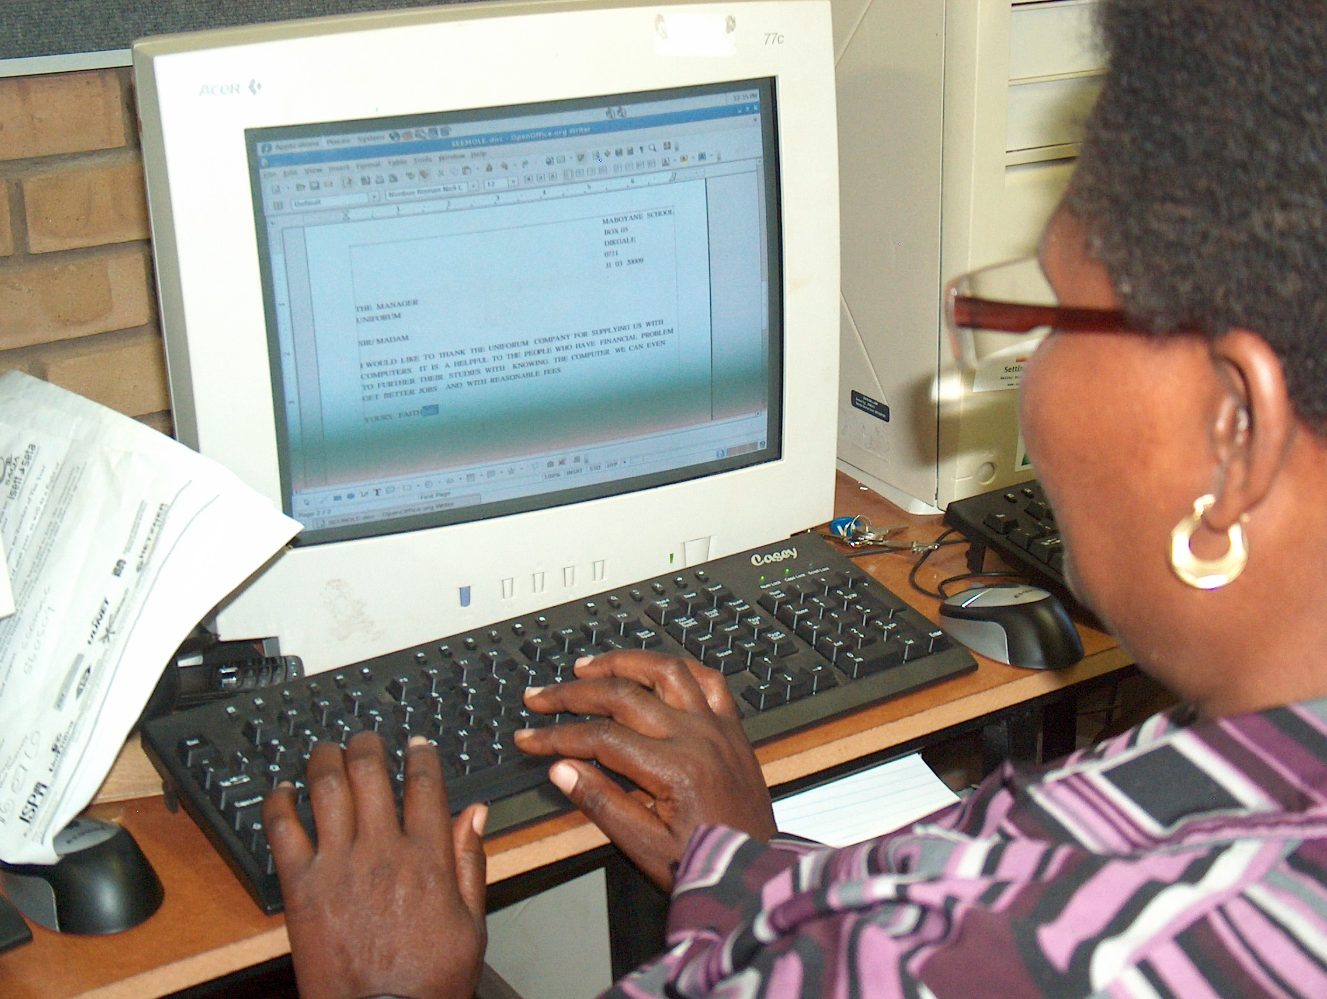
7 June 2016
Bridge Maths & Science CoP

Slide 20
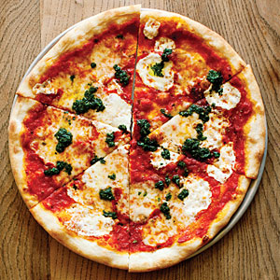
The CoZa Cares Model of Sustainable ICT environments in schools
7 June 2016
Bridge Maths & Science CoP

Slide 21

Infrastructure
Leadership & Operational Management
Digital Confidence
Pre-audits, monitoring, impact assessment
Technical & Trouble-shooting Support
Curriculum Integration
Connectivity
7 June 2016
Bridge Maths & Science CoP

Slide 22

DIGITAL CONTENT
7 June 2016
Bridge Maths & Science CoP

Slide 23


Breadbin’s education begins…
Content Curation Process
  Sourcing
  Aggregation
  Quality Assurance
  Curriculum alignment
7 June 2016
Bridge Maths & Science CoP

Slide 24
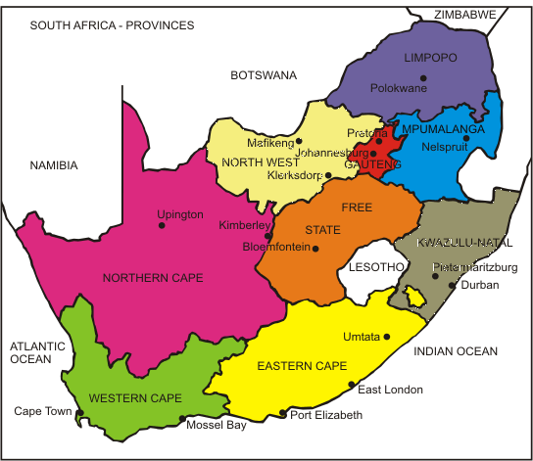
KIOSK PILOT 1:
9 units pilot – varied environments
KIOSK PILOT 2:
14 units – Education Department
chooses environments
7 June 2016
Bridge Maths & Science CoP

Slide 25
Easy to use
OERs work!
Custodian support
Fresh content
DoE CONNECTIVITY FIREWALLS
CUSTODIAN COMMUNICATION
CONTENT CURATION
HIGH TRAFFIC AREAS
Freedom Toaster Project
Open Source & Open Content
Off-line access
EASY TO USE!
“Teachers’ Toolbox”
John Thole - Edunova
The Digital Education Show Africa 2015
7 June 2016
Bridge Maths & Science CoP

Slide 26
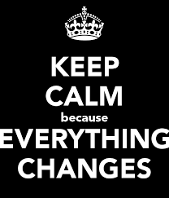

Limpopo Textbook crisis
Introduction of iPad tablets
DBE endorses Siyavula
7 June 2016
Bridge Maths & Science CoP

Slide 27


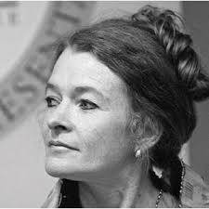
7 June 2016
Bridge Maths & Science CoP

Slide 28

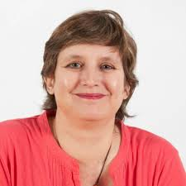
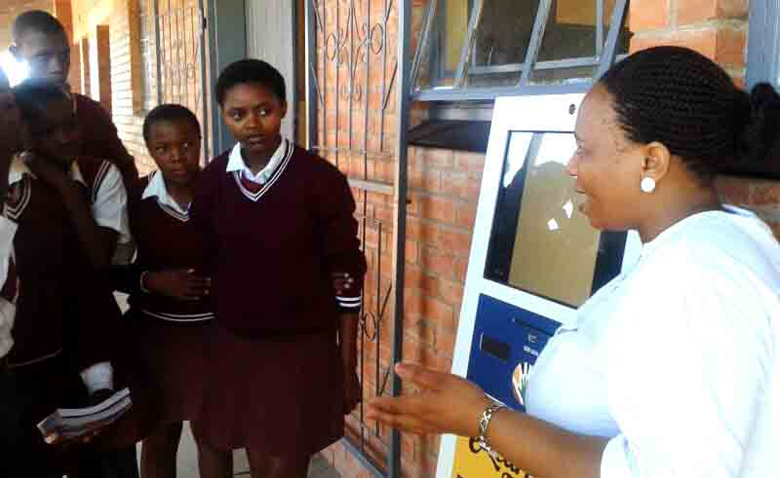
Focused on improving teaching strategies
Using technology for content creation
“If it can work in Cofimvaba
it can work everywhere” –
Merryl Ford
Programme Co-ordinator
7 June 2016
Bridge Maths & Science CoP

Slide 29
Easy to use
OERs work!
Custodian support
Fresh content
Content curation
DoE connectivity firewalls
Custodian communication
Content curation
High traffic areas
OFF-LINE, CACHED
SIMPLE NAVIGATION
CONTEXT = CONTENT
Freedom Toaster Project
Open Source & Open Content
Off-line access
EASY TO USE!
“Teachers’ Toolbox”
John Thole - Edunova
The Digital Education Show Africa 2015
7 June 2016
Bridge Maths & Science CoP

Slide 30
Nolwazi is born –
“She who knows all…”
7 June 2016
Bridge Maths & Science CoP

Slide 31
What is Nolwazi?
…yes, it does contain
OER textbooks – Siyavula
Khan Academy videos
Learning Channel content
NSC & ANA Exam papers
DBE Workbooks
…same old same old?
7 June 2016
Bridge Maths & Science CoP

Slide 32
What Nolwazi is NOT
MOOCs
CAPS School Calendar based
Learning Pathways
Paid-for content
Everything to everybody
7 June 2016
Bridge Maths & Science CoP

Slide 33


7 June 2016
Bridge Maths & Science CoP

Slide 34

7 June 2016
Bridge Maths & Science CoP

Slide 35
South African Teachers
Unique content
Practice-based
Current
User grading
Enriching content
What makes & will make
Nolwazi different?
7 June 2016
Bridge Maths & Science CoP

Slide 36
Easy to use
OERs work!
Custodian support
Fresh content
Content curation
DoE connectivity firewalls
Custodian communication
Content curation
High traffic areas
Off-line, cached
Simple navigation
Context = content
SA TEACHER-CREATED CONTENT
UNEXPECTED GEMS FROM UNEXPECTED SOURCES
Freedom Toaster Project
Open Source & Open Content
Off-line access
EASY TO USE!
“Teachers’ Toolbox”
John Thole - Edunova
The Digital Education Show Africa 2015
7 June 2016
Bridge Maths & Science CoP

Slide 37
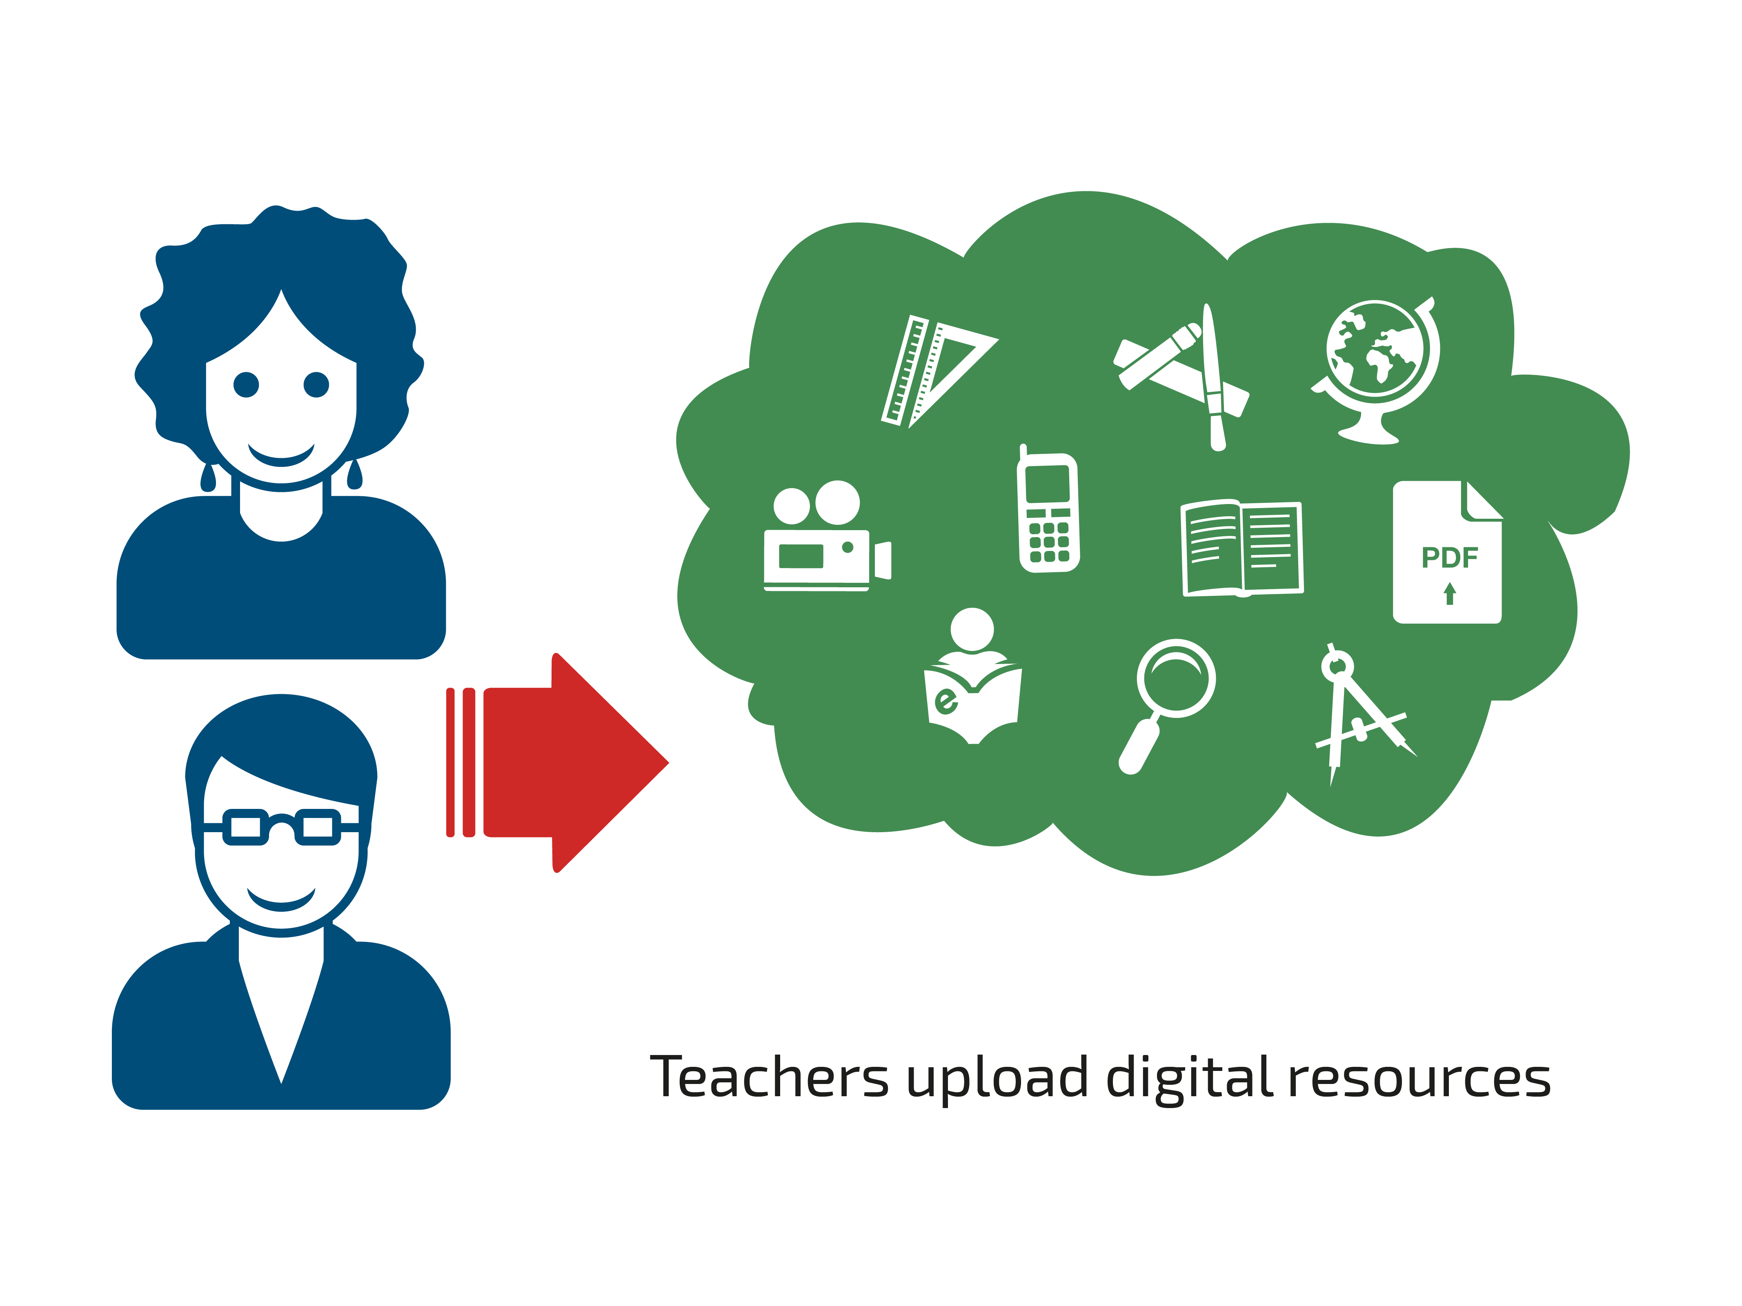
7 June 2016
Bridge Maths & Science CoP

Slide 38
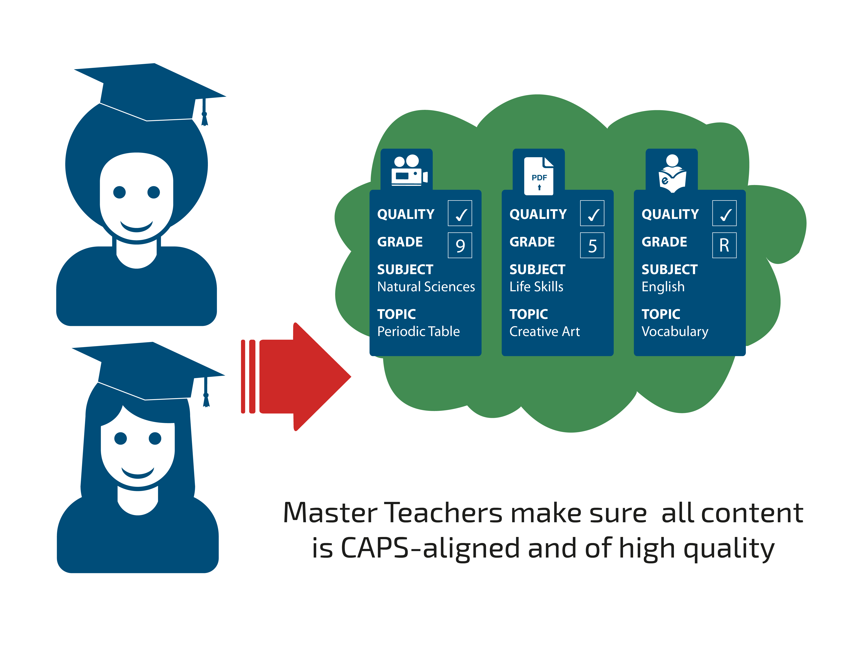
7 June 2016
Bridge Maths & Science CoP

Slide 39
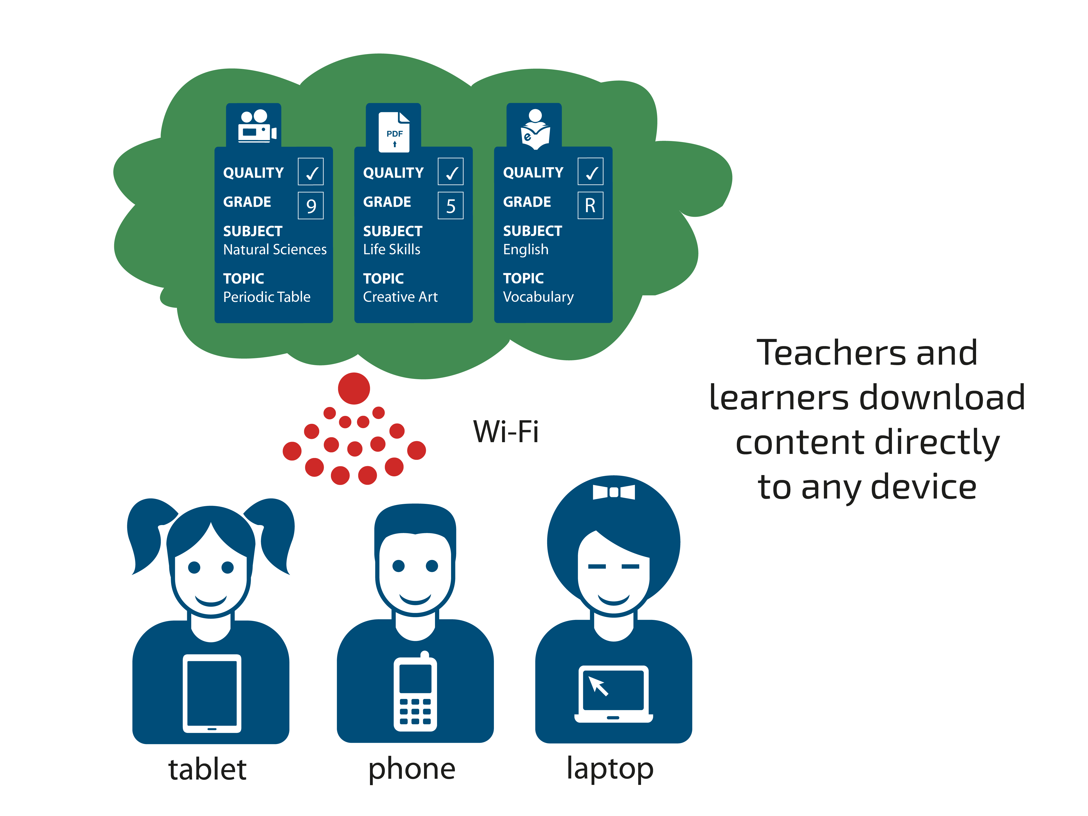
7 June 2016
Bridge Maths & Science CoP

Slide 40
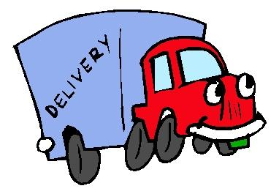
WEB PLATFORM TO USERS
KIOSK TO USERS
SERVER TO USERS
???? TO USERS
WEB PORTAL TO USERS
Freedom Toaster Project
Open Source & Open Content
Off-line access
EASY TO USE!
“Teachers’ Toolbox”
John Thole - Edunova
The Digital Education Show Africa 2015
7 June 2016
Bridge Maths & Science CoP

Slide 41
Easy to use
OERs work!
Custodian support
Fresh content
Content curation
DoE connectivity firewalls
Custodian communication
Content curation
High traffic areas
Off-line, cached
Simple navigation
Context = content
SA teacher-created content
Unexpected gems from unexpected sources
ONE-STOP-SHOP FOR CURATED OPEN EDUCATIONAL RESOURCES FOR SOUTH AFRICA
Freedom Toaster Project
Open Source & Open Content
Off-line access
EASY TO USE!
“Teachers’ Toolbox”
John Thole - Edunova
The Digital Education Show Africa 2015
7 June 2016
Bridge Maths & Science CoP

Slide 42

Join us
on the
Nolwazi journey!
7 June 2016
Bridge Maths & Science CoP

Slide 43
info@nolwazi.co.za
www.nolwazi.co.za
@Nolwazi_ZA
#NolwaziOER
7 June 2016
Bridge Maths & Science CoP

